Slide 1

Structured Training for
Neural Network
Transition-Based Parsing
David Weiss, Chris Alberti, Michael Collins, Slav Petrov

Slide 2

[Chen & Manning, 2014]
[EMNLP14]A Fast and Accurate Dependency Parser
using Neural Networks

Slide 3
[Chen & Manning, 2014]
stack0-word = “ticket”
buffer0-word = “to”
stack0-label = “det”
buffer0-POS = “IN”

Slide 4
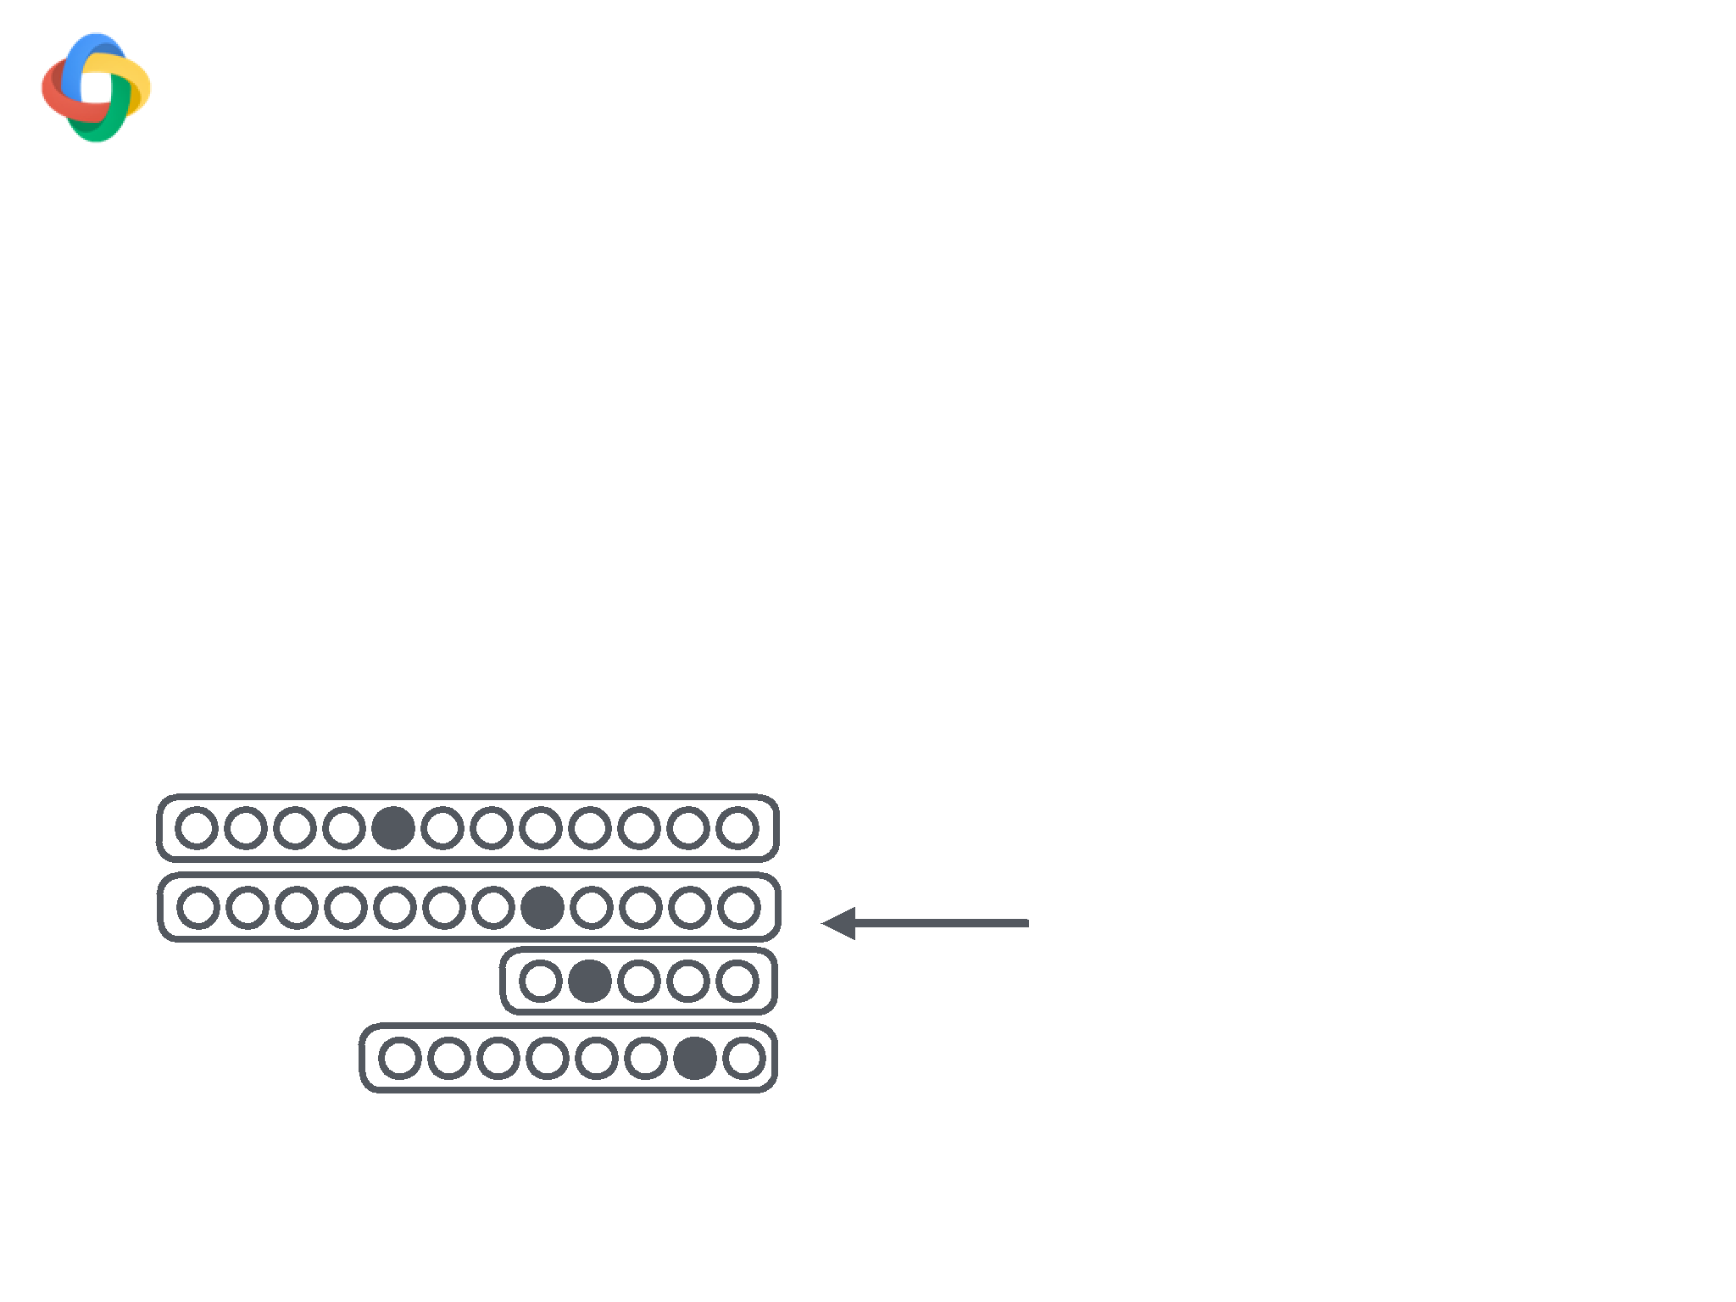
[Chen & Manning, 2014]
stack0-word = “ticket”
buffer0-word = “to”
stack0-label = “det”
buffer0-POS = “IN”

Slide 5
[Chen & Manning, 2014]
Embedding Layer
stack0-word = “ticket”
buffer0-word = “to”
stack0-label = “det”
buffer0-POS = “IN”

Slide 6
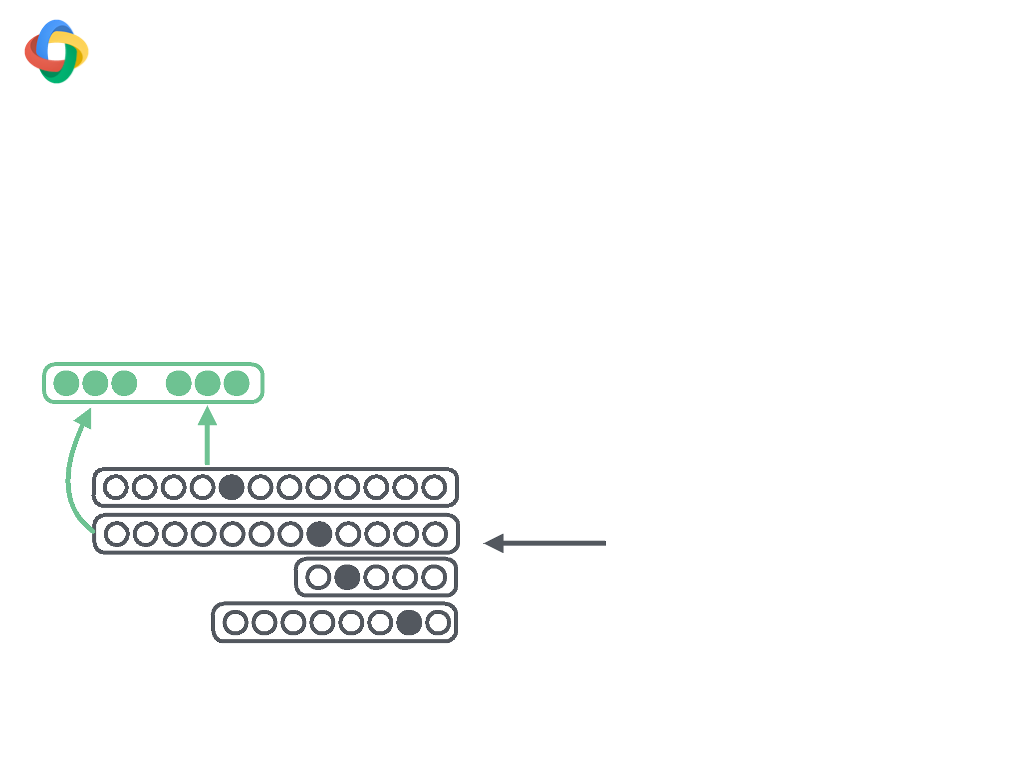
[Chen & Manning, 2014]
Embedding Layer
(words
stack0-word = “ticket”
buffer0-word = “to”
stack0-label = “det”
buffer0-POS = “IN”

Slide 7
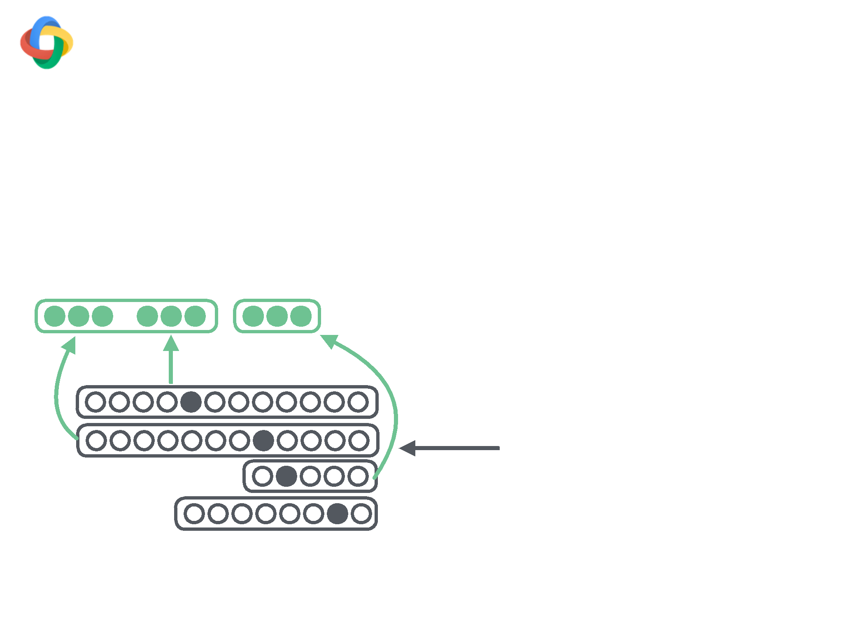
[Chen & Manning, 2014]
Embedding Layer
(words labels
stack0-word = “ticket”
buffer0-word = “to”
stack0-label = “det”
buffer0-POS = “IN”

Slide 8
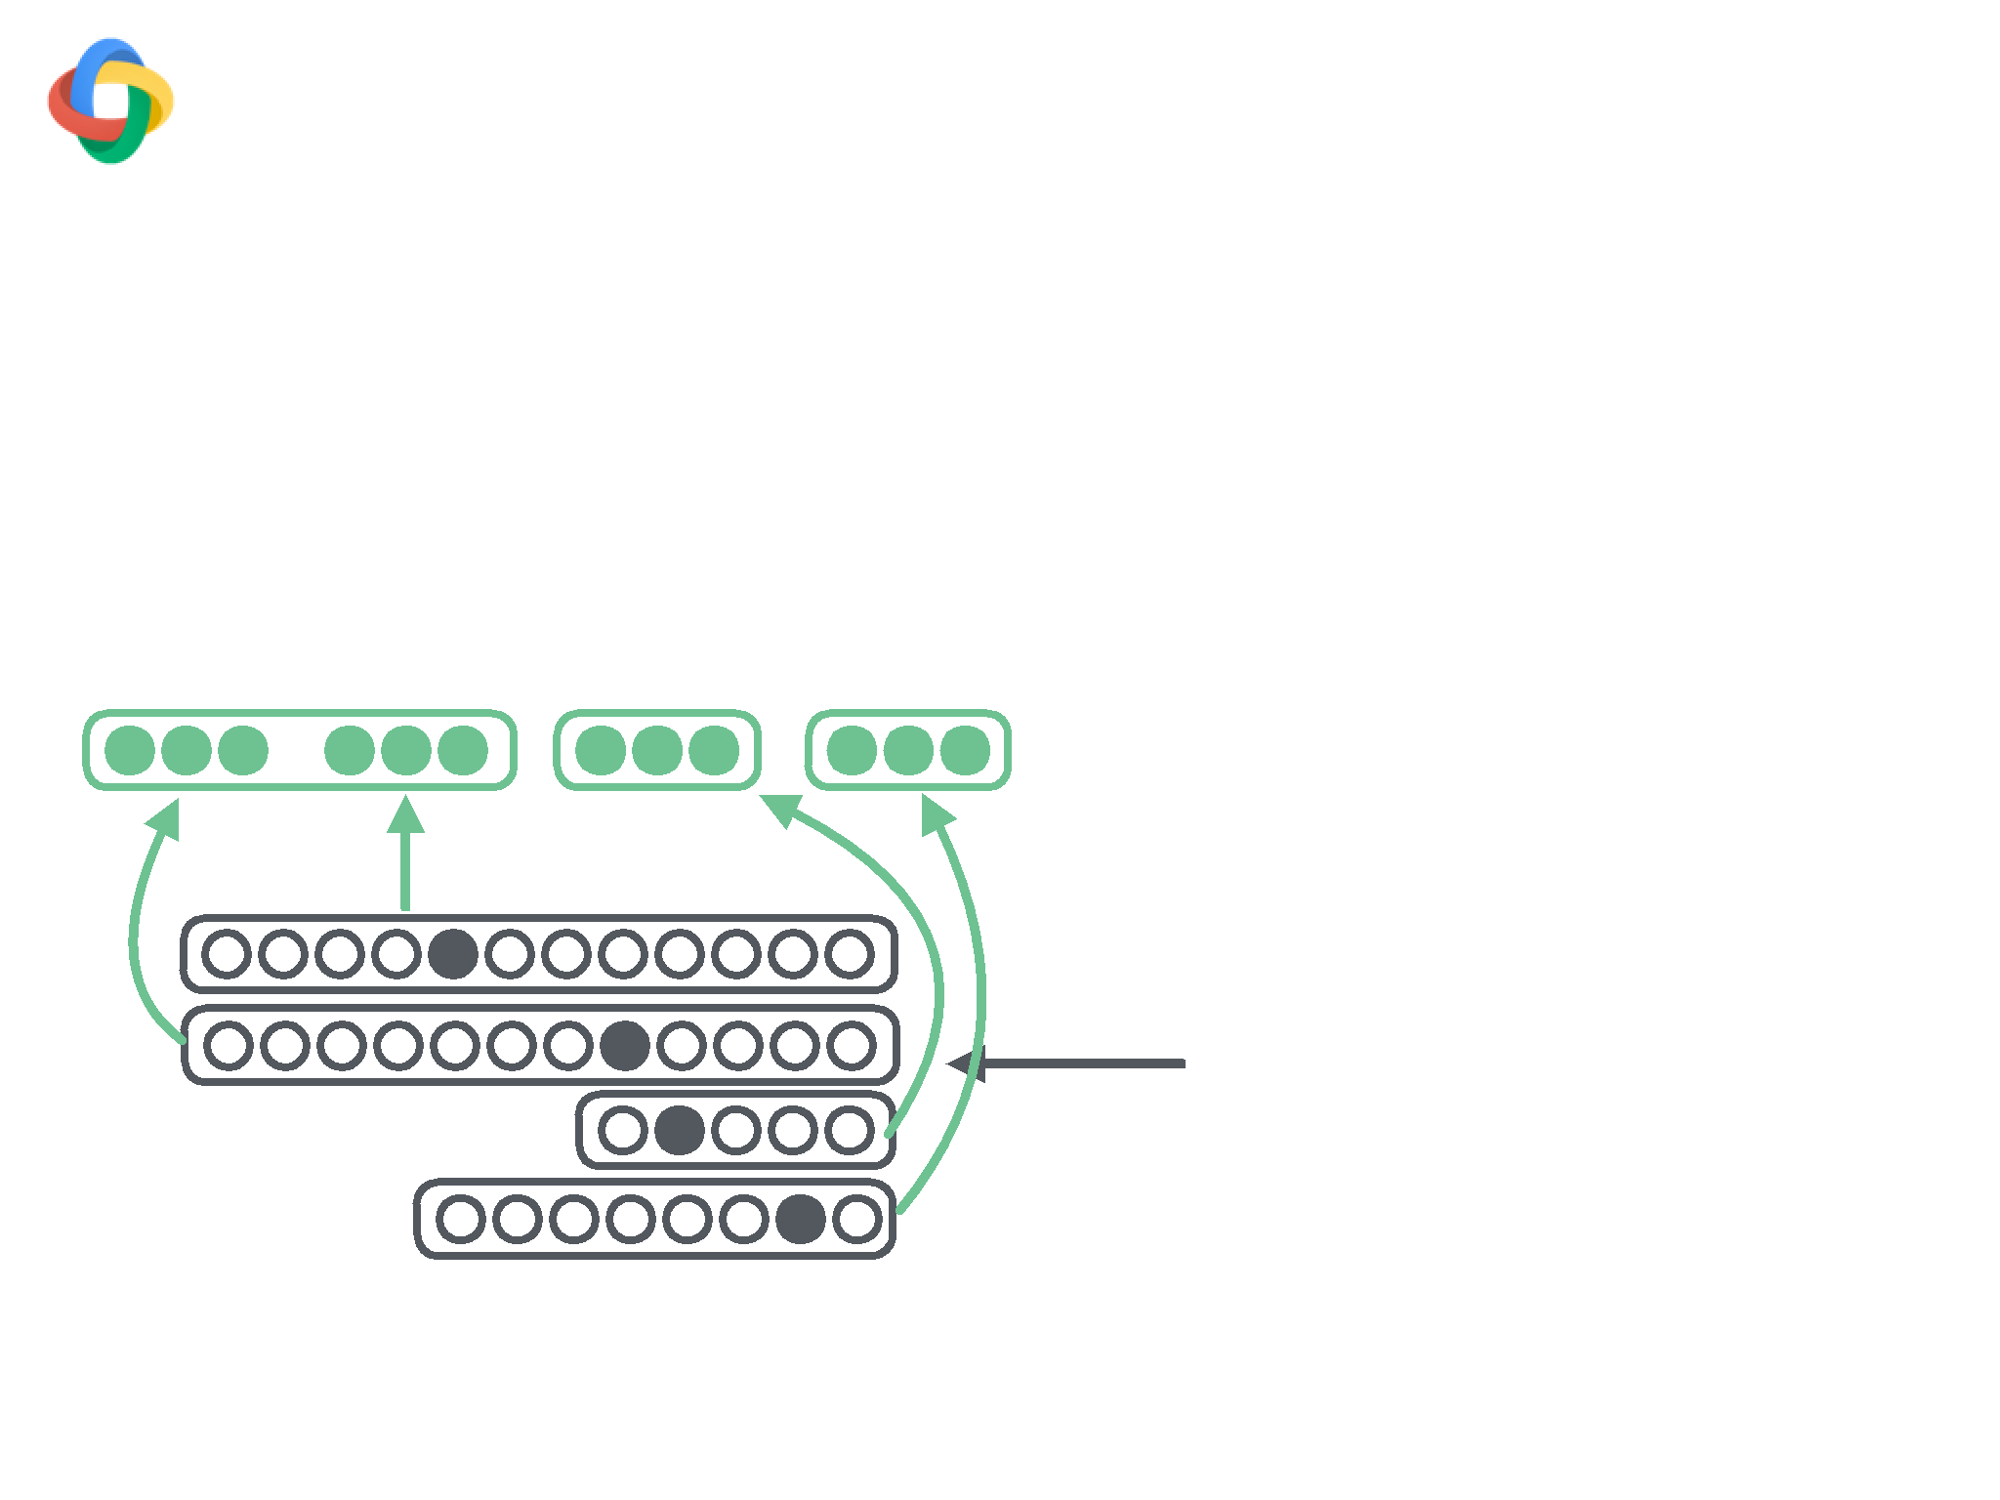
[Chen & Manning, 2014]
Embedding Layer
(words labels pos)
stack0-word = “ticket”
buffer0-word = “to”
stack0-label = “det”
buffer0-POS = “IN”

Slide 9
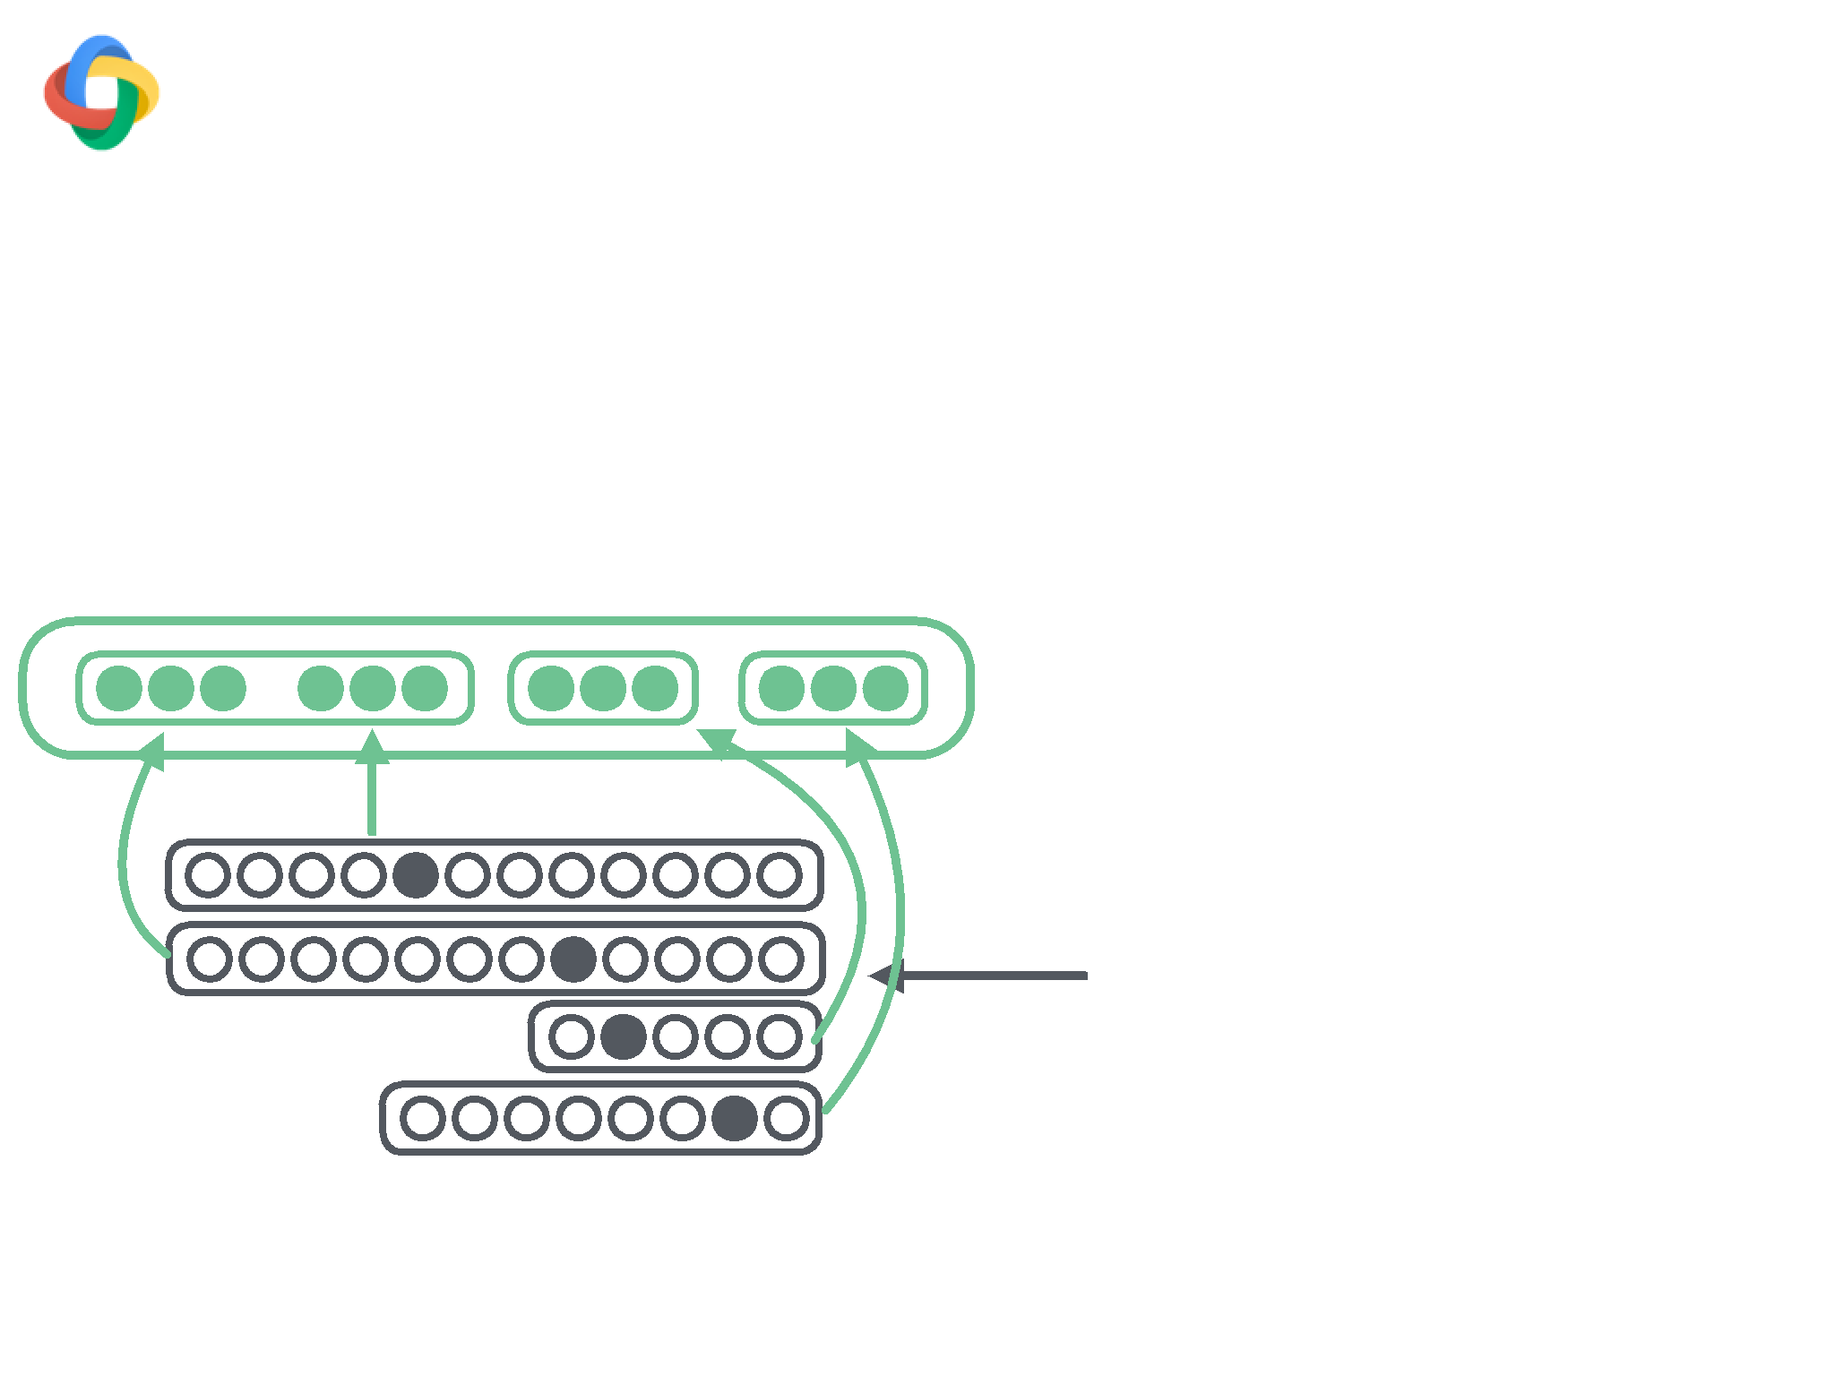
[Chen & Manning, 2014]
Embedding Layer
(words labels pos)
stack0-word = “ticket”
buffer0-word = “to”
stack0-label = “det”
buffer0-POS = “IN”

Slide 10
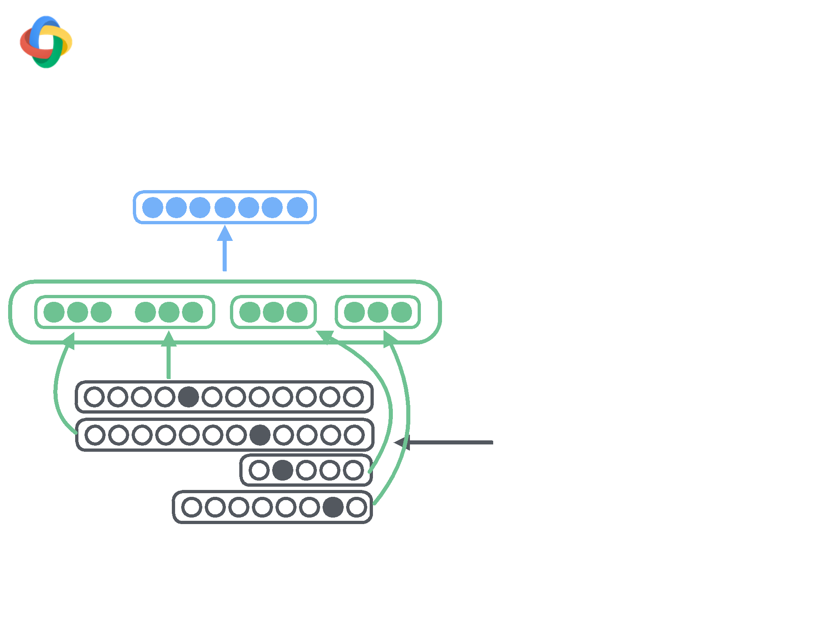
[Chen & Manning, 2014]
Hidden Layer
Embedding Layer
(words labels pos)
stack0-word = “ticket”
buffer0-word = “to”
stack0-label = “det”
buffer0-POS = “IN”

Slide 11
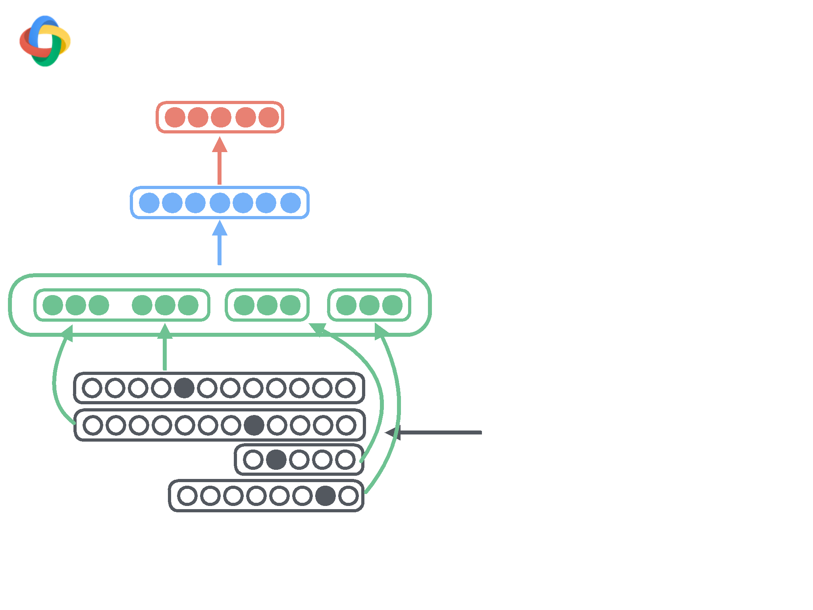
[Chen & Manning, 2014]
Softmax Layer
Hidden Layer
Embedding Layer
(words labels pos)
stack0-word = “ticket”
buffer0-word = “to”
stack0-label = “det”
buffer0-POS = “IN”

Slide 12
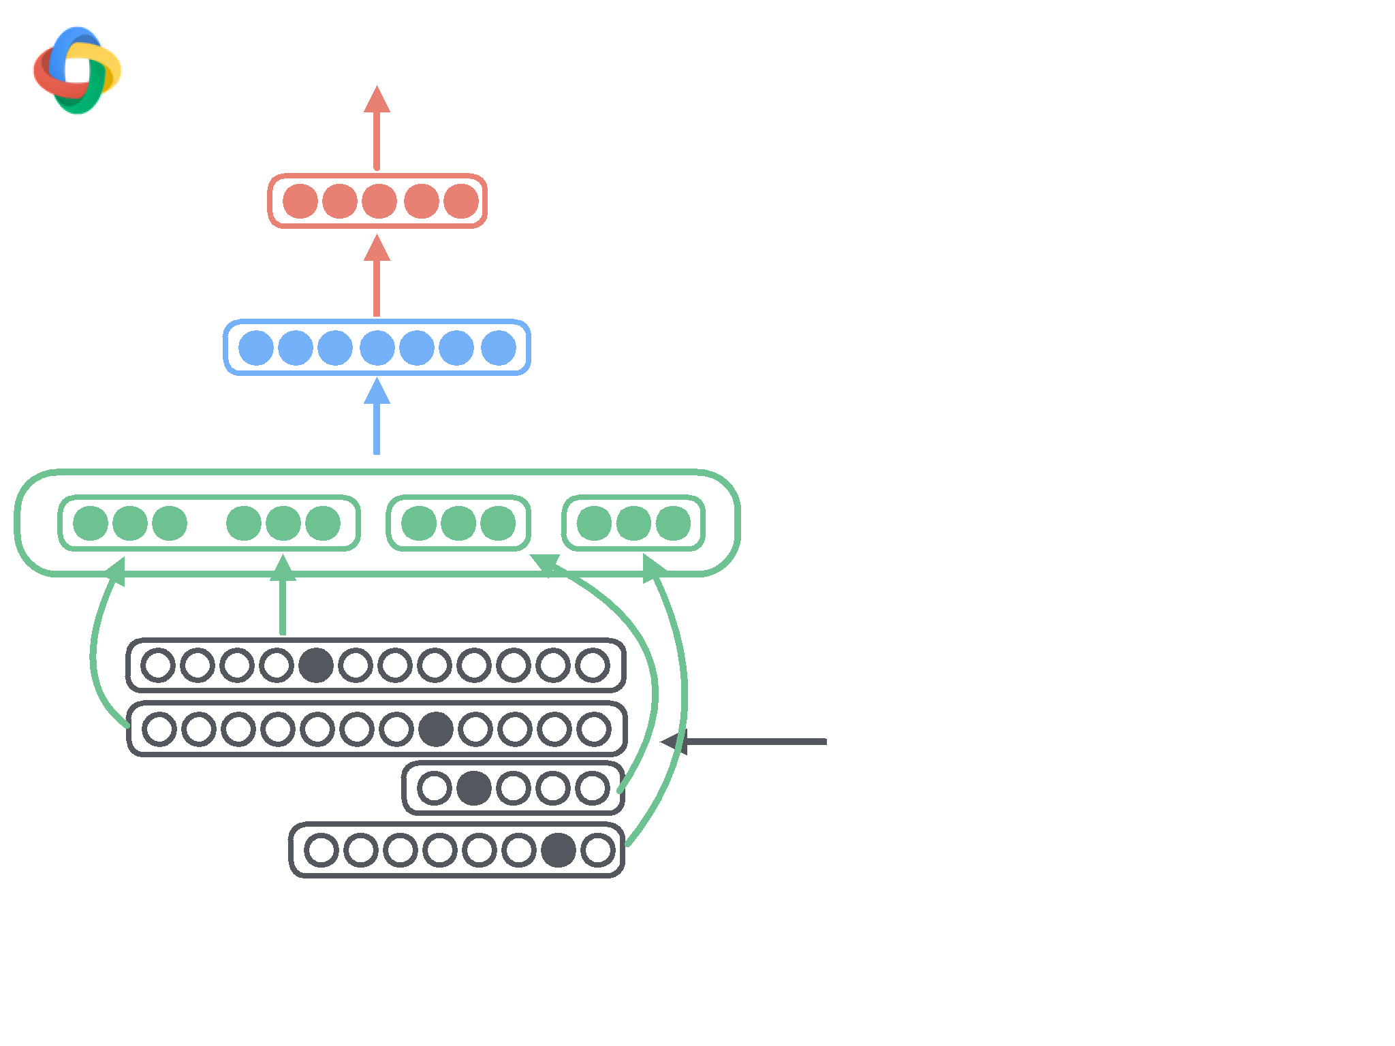
[Chen & Manning, 2014]
Softmax Layer
Hidden Layer
Embedding Layer
(words labels pos)
stack0-word = “ticket”
buffer0-word = “to”
stack0-label = “det”
buffer0-POS = “IN”

Slide 13
# From Single Words
# valency
pair { stack.tag stack.word }
pair { stack.word stack.valence(-1) }
stack { word tag }
pair { stack.word stack.valence(1) }
pair { input.tag input.word }
pair { stack.tag stack.valence(-1) }
input { word tag }
pair { stack.tag stack.valence(1) }
pair { input(1).tag input(1).word }
pair { input.word input.valence(-1) }
input(1) { word tag }
pair { input.tag input.valence(-1) }
pair { input(2).tag input(2).word }
# unigrams
input(2) { word tag }
stack.head(1) {word tag}
# From
word pairs
stack.label
quad {
stack.tag stack.word input.tag input.word }
stack.child(-1) {word tag label}
triple
{ stack.tag stack.word input.word }
stack.child(1) {word tag label}
triple
{ stack.word input.tag input.word }
input.child(-1) {word tag label}
triple
{ stack.tag stack.word input.tag }
# third order
triple
{ stack.tag input.tag input.word }
stack.head(1).head(1) {word tag}
pair {
stack.word input.word }
stack.head(1).label
pair {
stack.tag input.tag }
stack.child(-1).sibling(1) {word tag label}
pair {
input.tag input(1).tag }
stack.child(1).sibling(-1) {word tag label}
# From
word triples
input.child(-1).sibling(1) {word tag label}
triple
{ input.tag input(1).tag input(2).tag }
triple { stack.tag stack.child(-1).tag stack.child(-1).sibling(1)
triple
{ stack.tag input.tag input(1).tag }
triple { stack.tag stack.child(1).tag stack.child(1).sibling(-1).
triple
{ stack.head(1).tag stack.tag input.tag }
triple { stack.tag stack.head(1).tag stack.head(1).head(1).tag }
triple
{ stack.tag stack.child(-1).tag input.tag }
triple { input.tag input.child(-1).tag input.child(-1).sibling(1)
triple
{ stack.tag stack.child(1).tag input.tag }
# label set
triple
{ stack.tag input.tag input.child(-1).tag }
pair { stack.tag stack.child(-1).label }
# Distance
triple { stack.tag stack.child(-1).label stack.child(-1).sibling(
pair { stack.distance stack.word }
quad { stack.tag stack.child(-1).label stack.child(-1).sibling(1)
pair { stack.distance stack.tag }
pair { stack.tag stack.child(1).label }
pair { stack.distance input.word }
triple { stack.tag stack.child(1).label stack.child(1).sibling(-1
pair { stack.distance input.tag }
quad { stack.tag stack.child(1).label stack.child(1).sibling(-1).
triple { stack.distance stack.word input.word }
pair { input.tag input.child(-1).label }
triple { stack.distance stack.tag input.tag }
triple { input.tag input.child(-1).label input.child(-1).sibling(
quad { input.tag input.child(-1).label input.child(-1).sibling(1)

Slide 14
How far can we push this
architecture?

Slide 15

How far can NN go? (Outline)
WSJ §23
Method
UAS LAS Beam
Baseline (Chen & Manning, 2014)
91.80 89.60
1
3rd-order Graph-based (ZM2014)
93.22 91.02
-
Transition-based Linear (ZN2011)
93.00 90.95
32
Ours (Better SGD)
92.58 90.54
1
Ours (Deeper network)
93.19 91.18
1
Ours (Perceptron)
93.99 92.05
8
+2.46 UAS
Ours (+Semi-supervised)
94.26 92.41
8
+2.81 LAS
S-LSTM (Dyer et al.,2015)
93.20 90.90
1
Contrastive NN (Zhou et al., 2015)
92.83
—
100

Slide 16
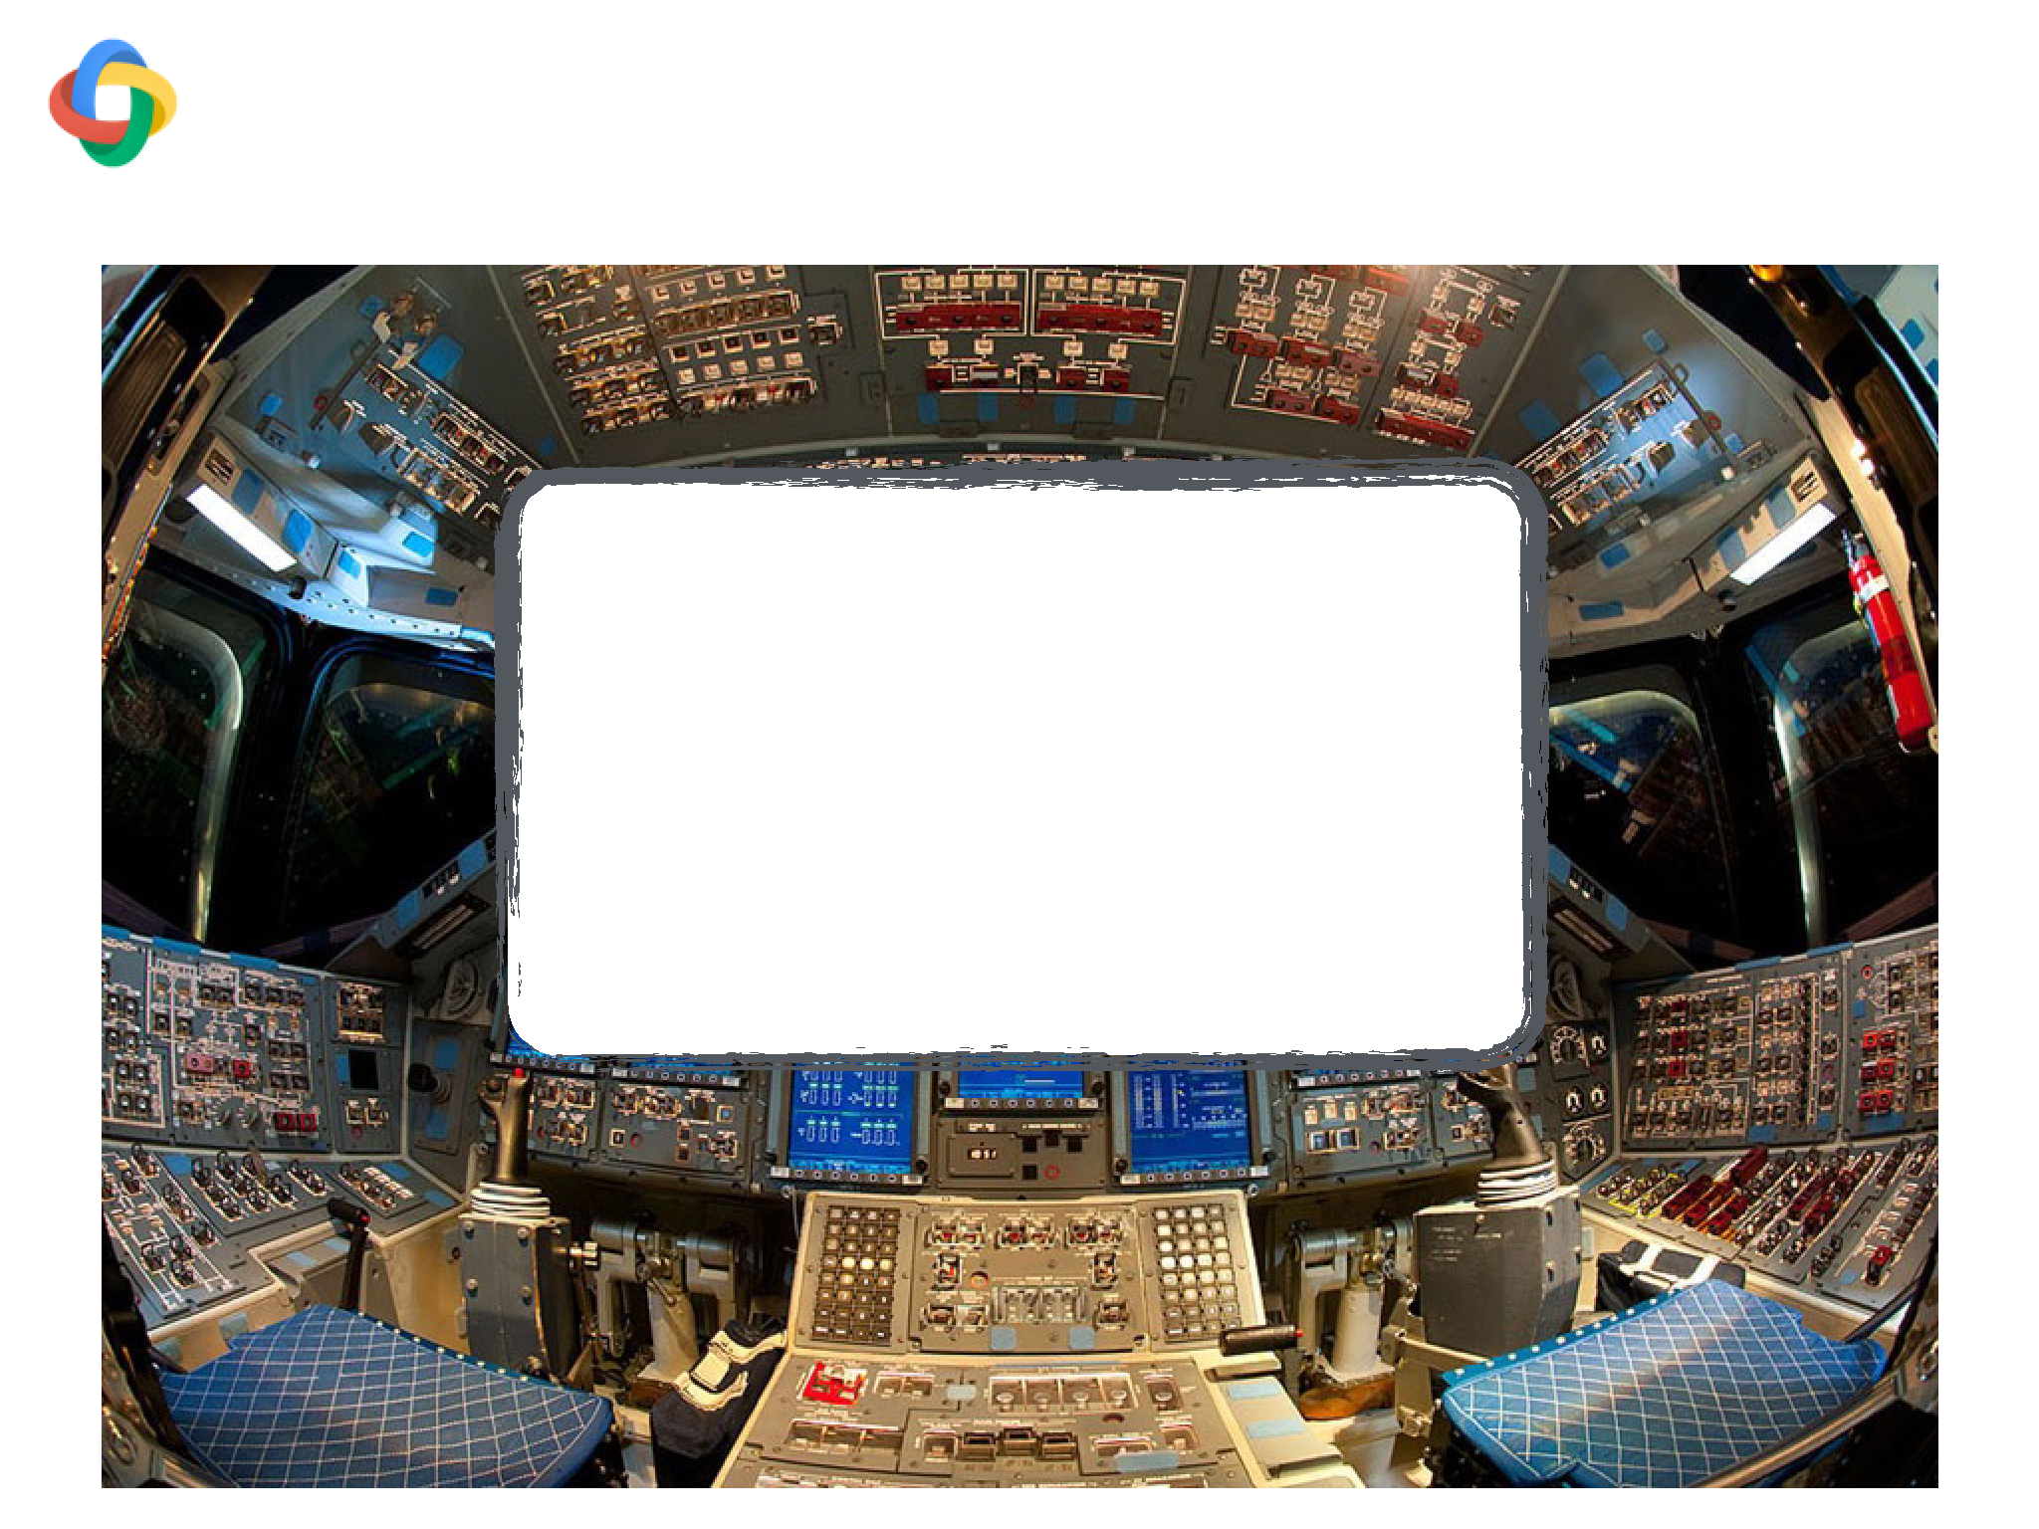
Use random restarts, grid search
Pick best using holdout data
Tune: WSJ S24 (grid search)
Dev: WSJ S22 (development)
Test: WSJ S23 (final results)

Slide 17
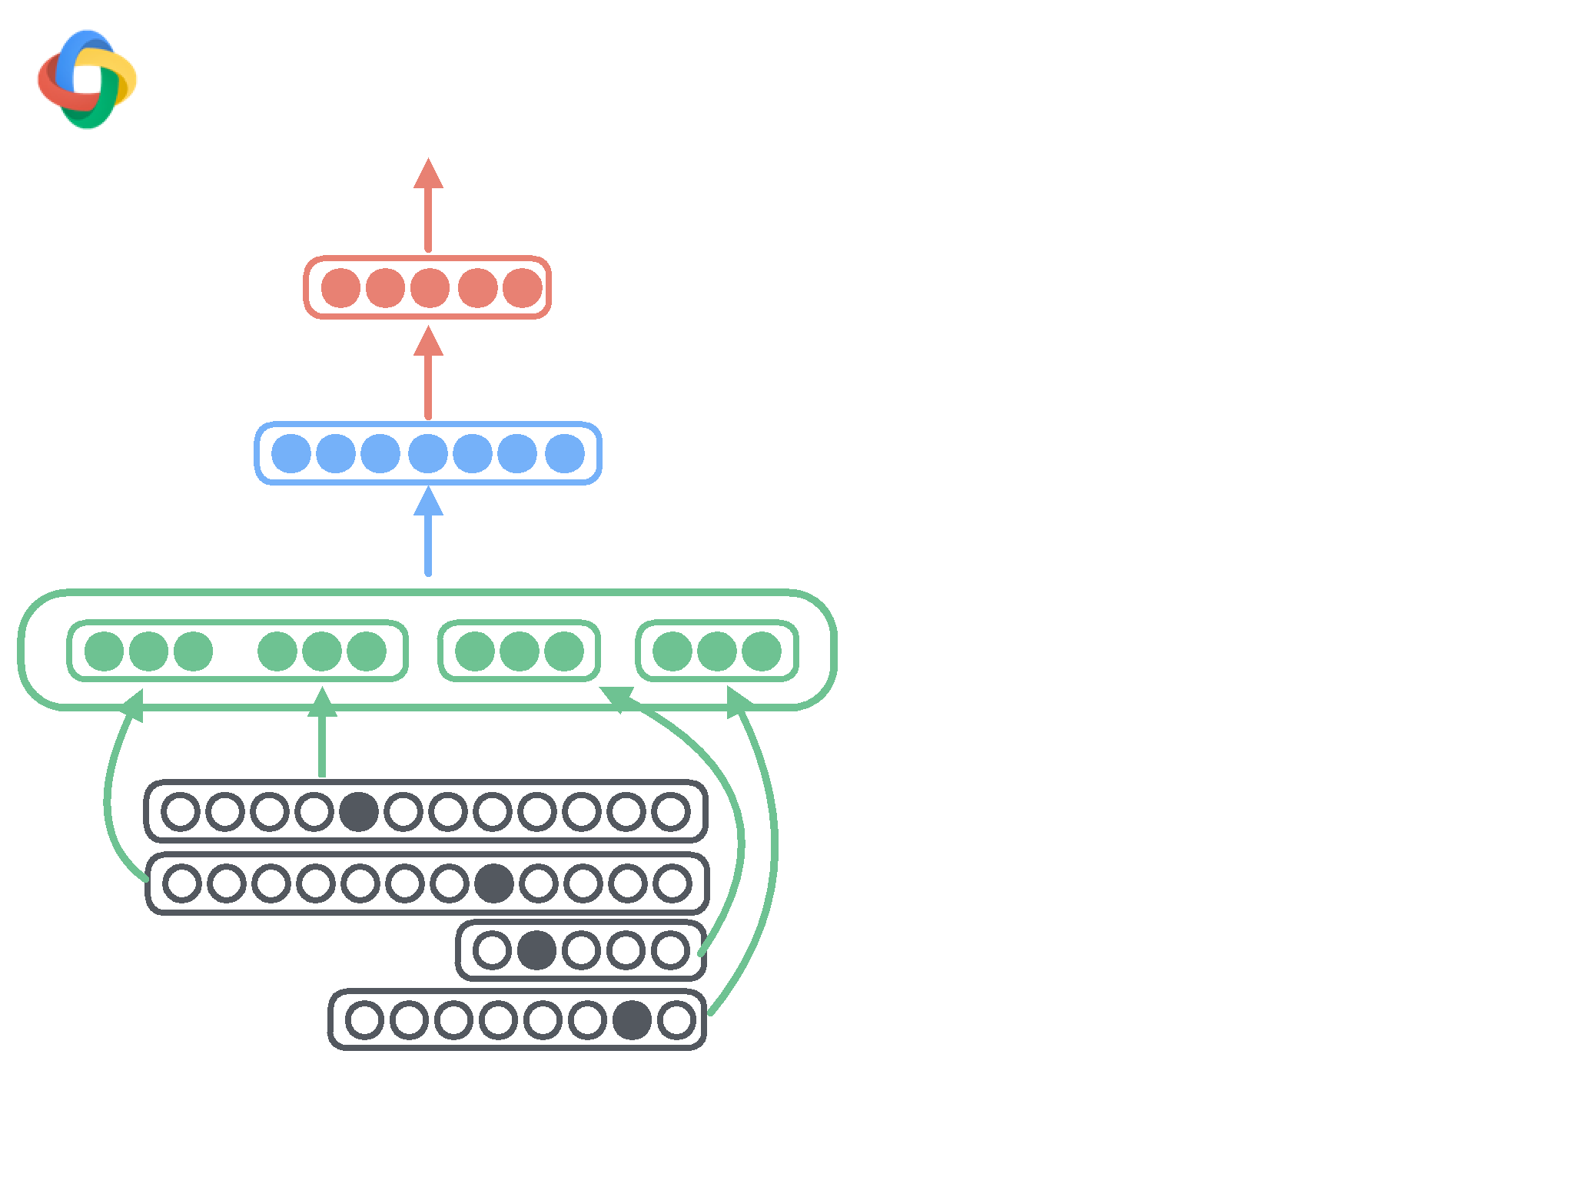
Lessons learned:

Slide 18
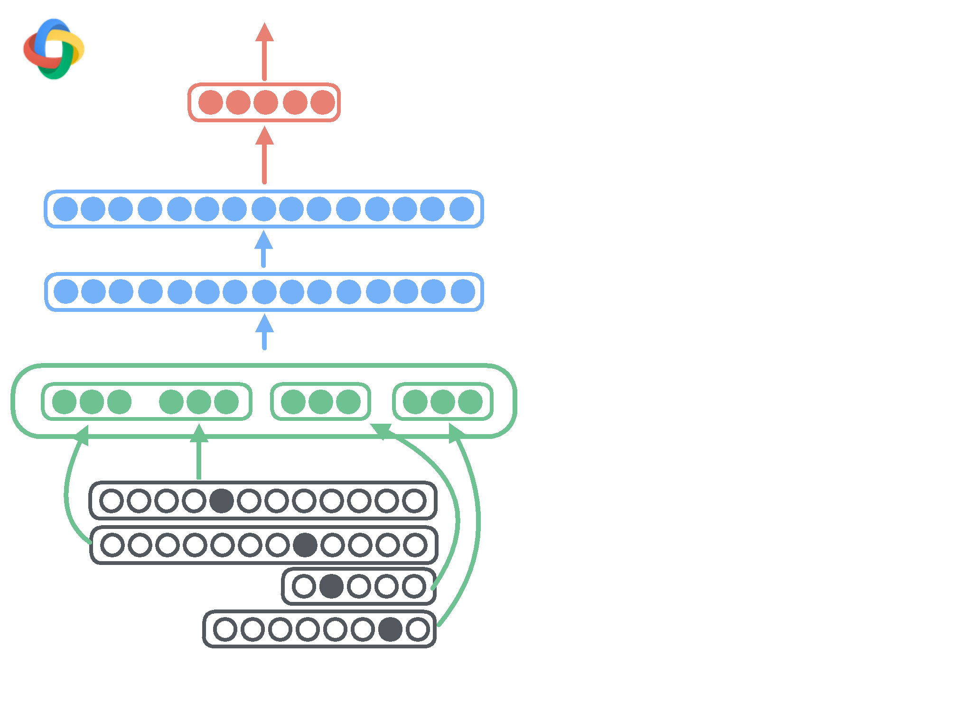
Lessons learned:

Slide 19
Lessons learned:
-
Deeper, bigger network
2048x2048 hidden units

Slide 20

Lessons learned:
-
Deeper, bigger network
2048x2048 hidden units
-
ReLU (cubic)

Slide 21

Lessons learned:
-
Deeper, bigger network
2048x2048 hidden units
-
ReLU (cubic)
-
Adagrad

Slide 22

Lessons learned:
-
Deeper, bigger network
2048x2048 hidden units
-
ReLU (cubic)
-
Adagrad
-
Dropout

Slide 23
Lessons learned:
-
Deeper, bigger network
2048x2048 hidden units
-
ReLU (cubic)
-
Adagrad
-
Dropout
-
SGD with momentum

Slide 24
Lessons learned:
-
Deeper, bigger network
2048x2048 hidden units
-
ReLU (cubic)
-
Adagrad
-
Dropout
-
SGD with momentum
-
Fixed learning rate
schedule

Slide 25
Lessons learned:
-
Deeper, bigger network
2048x2048 hidden units
-
ReLU (cubic)
-
Adagrad
-
Dropout
-
SGD with momentum
-
Fixed learning rate
schedule
-
Initialize word
embeddings (word2vec)

Slide 26

Outline
WSJ §23
Method
UAS LAS Beam
Baseline (Chen & Manning, 2014)
91.80 89.60
1
3rd-order Graph-based (ZM2014)
93.22 91.02
-
Transition-based Linear (ZN2011)
93.00 90.95
32
Ours (Better SGD)
92.58 90.54
1
1
Ours (Deeper network)
93.19 91.18
1
2
Ours (Perceptron)
93.99 92.05
8
3
Ours (+Semi-supervised)
94.26 92.41
8
S-LSTM (Dyer et al.,2015)
93.20 90.90
1
Contrastive NN (Zhou et al., 2015)
92.83
—
100

Slide 27
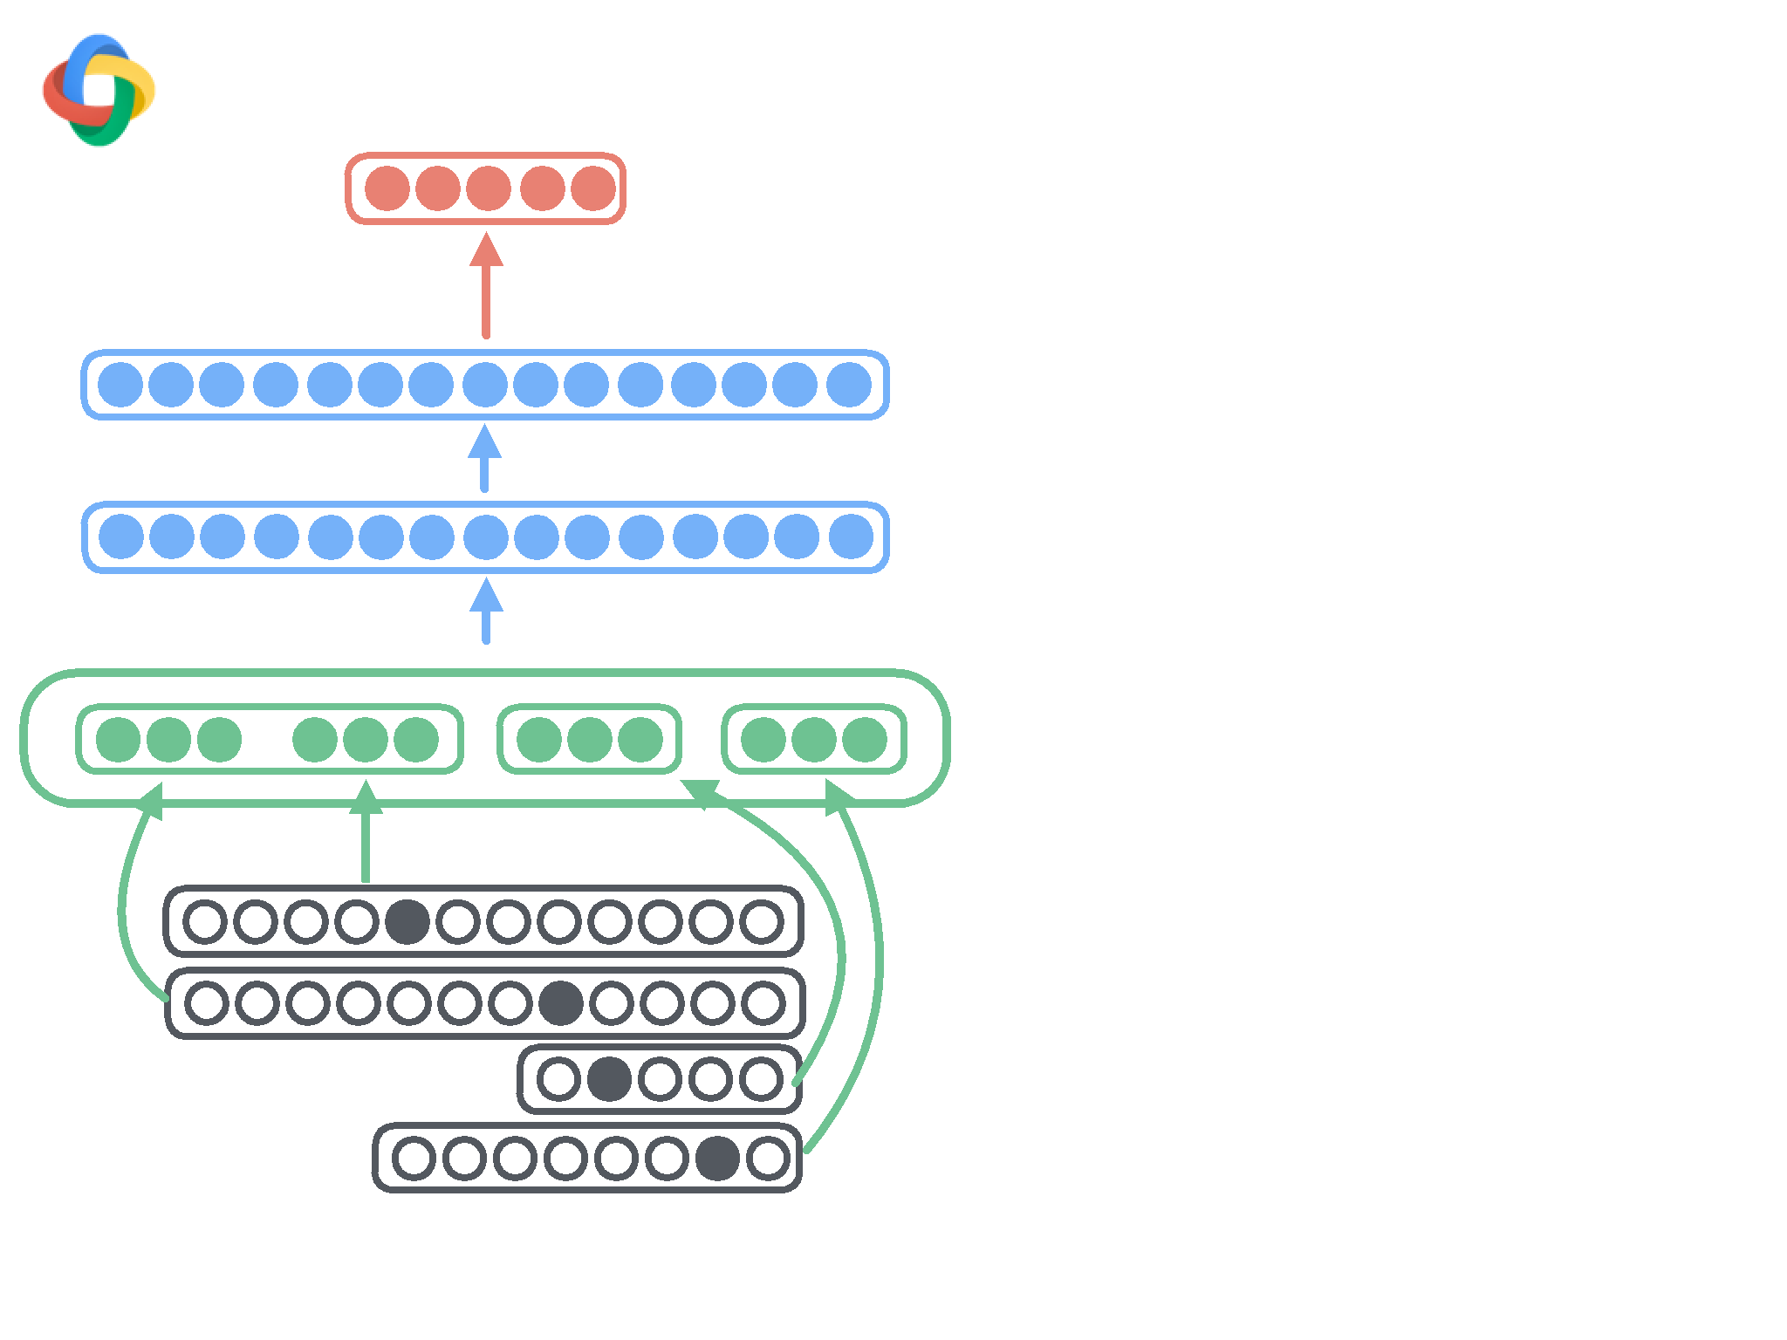

Slide 28
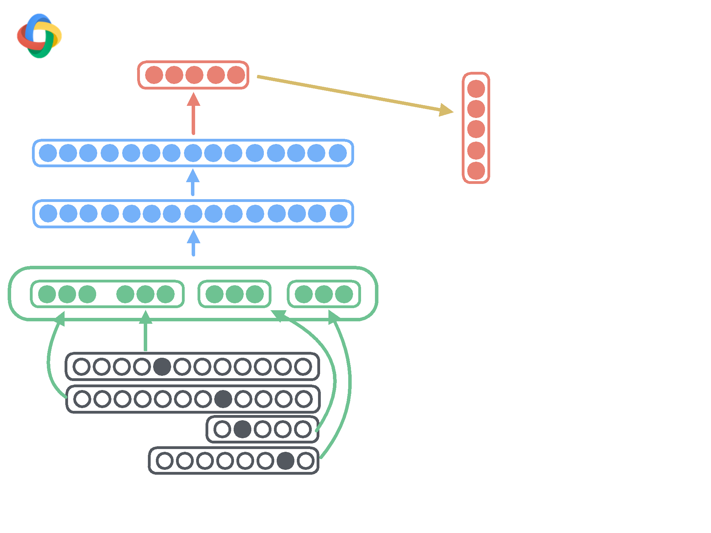

Slide 29
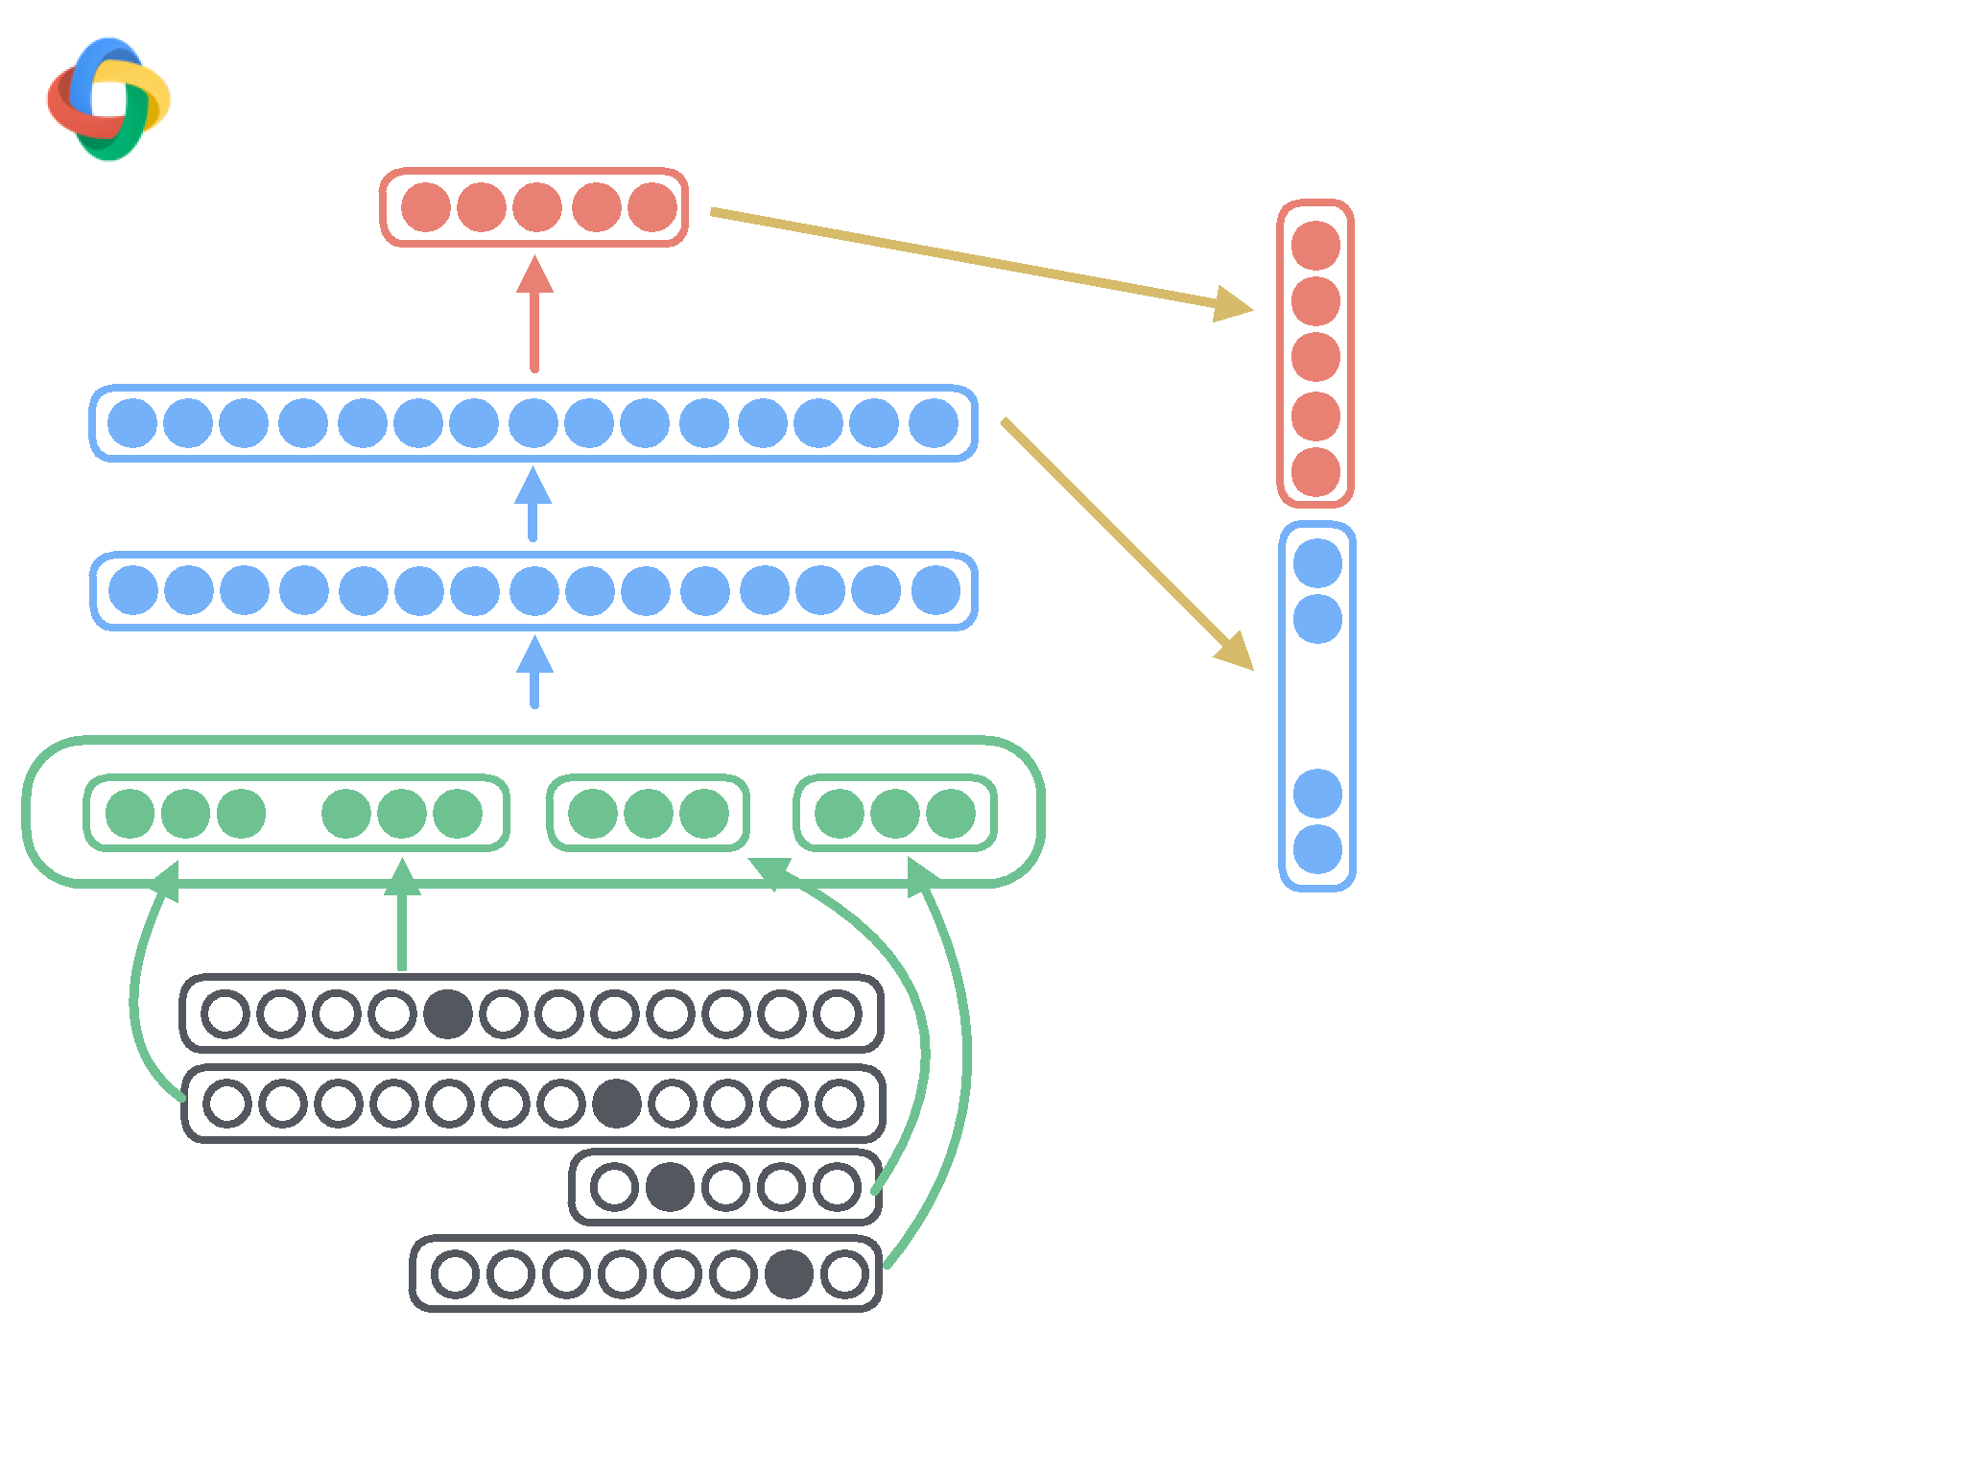
…

Slide 30
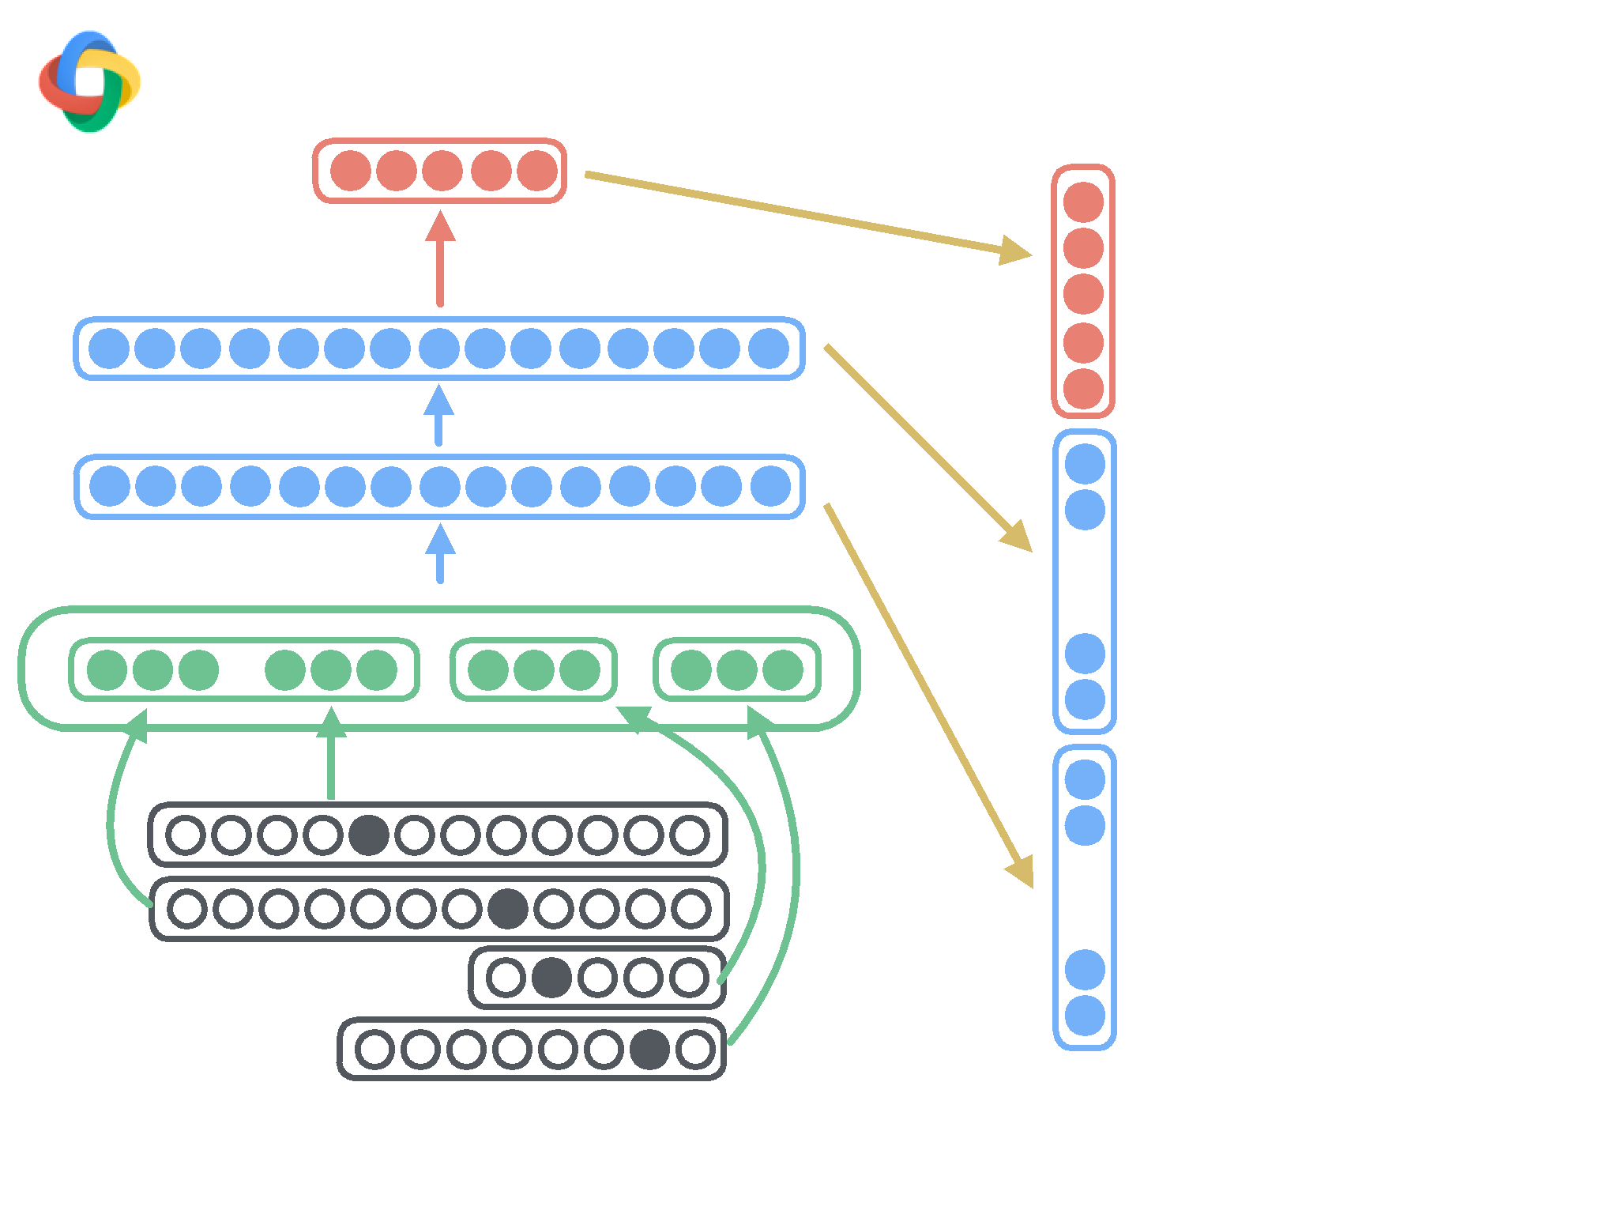
…
…

Slide 31
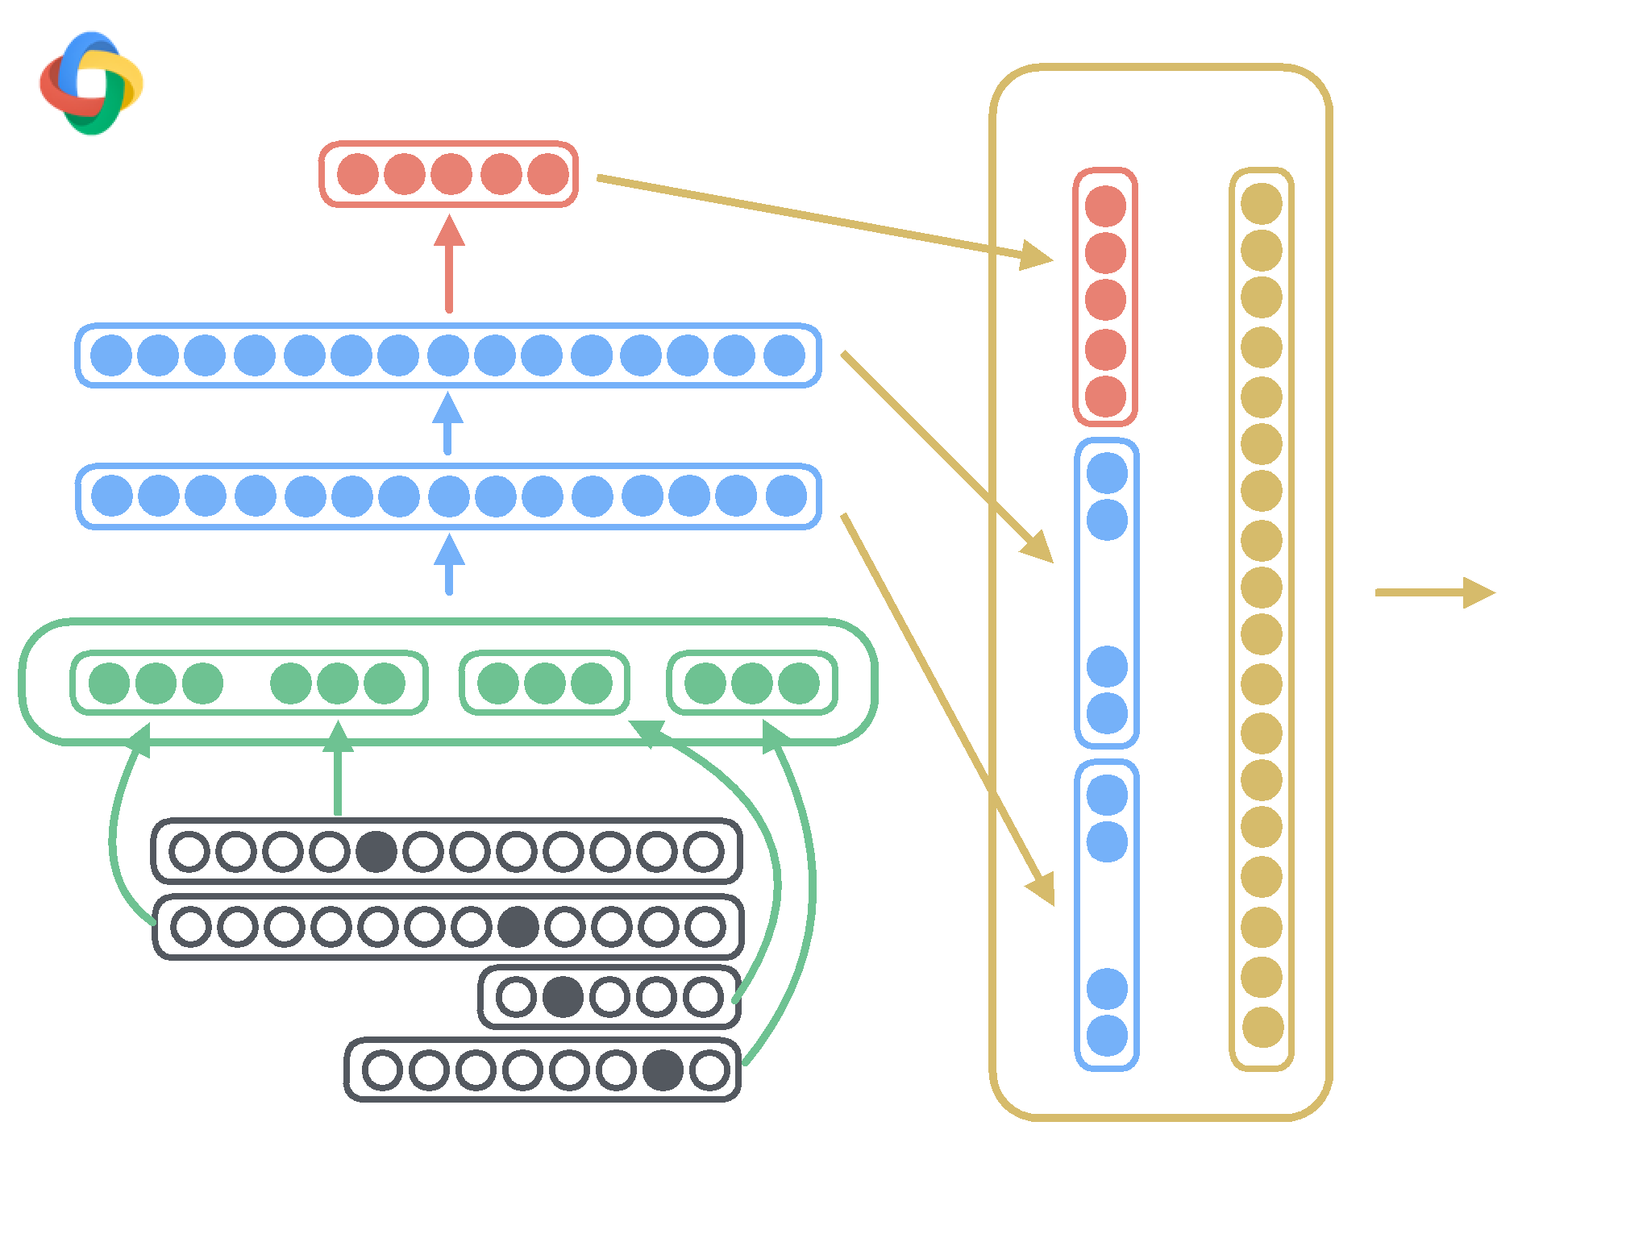
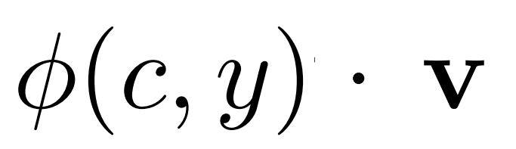
Structured
…
…

Slide 32
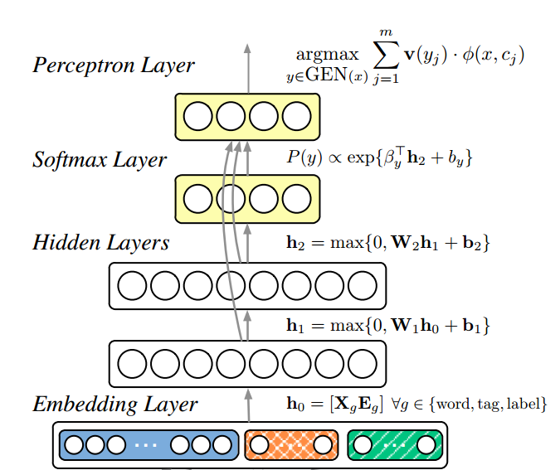

Slide 33
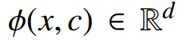
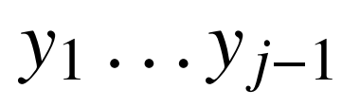

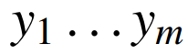
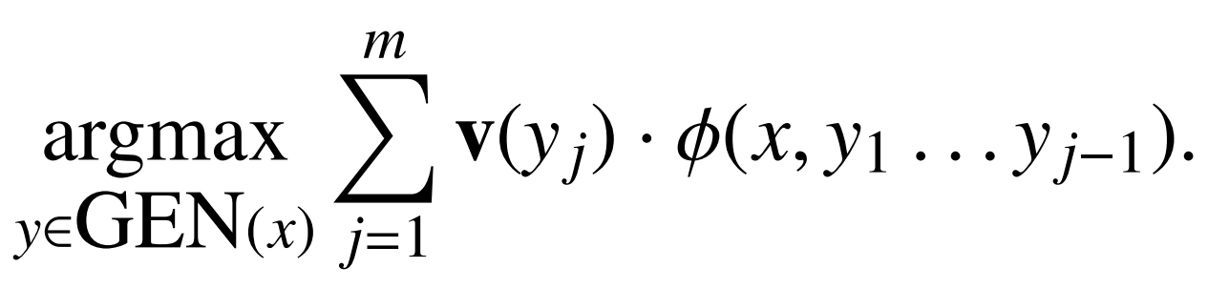
Perceptron Layer
There is a one-to-one mapping between configurations c and decision sequences for any integer j ≥ 1
For a sentence x, define GEN(x) to be the set of parse trees for x.
Each y GEN(x) is a sequence of decisions for some integer m.

Slide 34
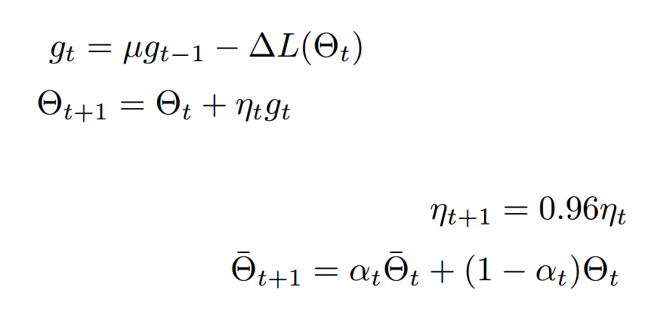
Back-propagation training

Slide 35
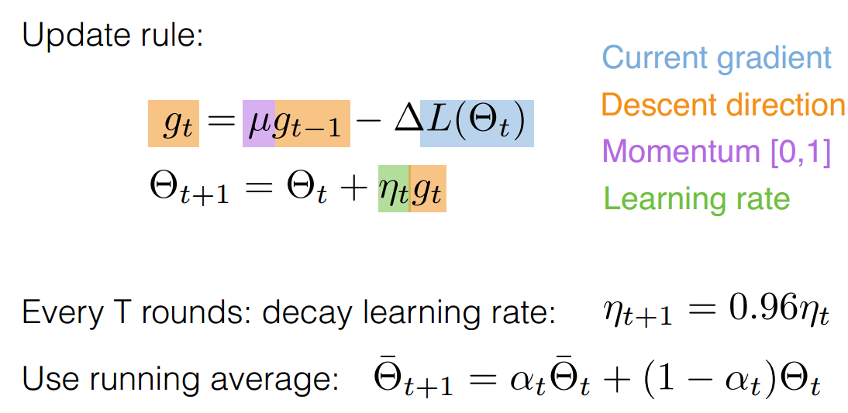
Back-propagation training

Slide 36

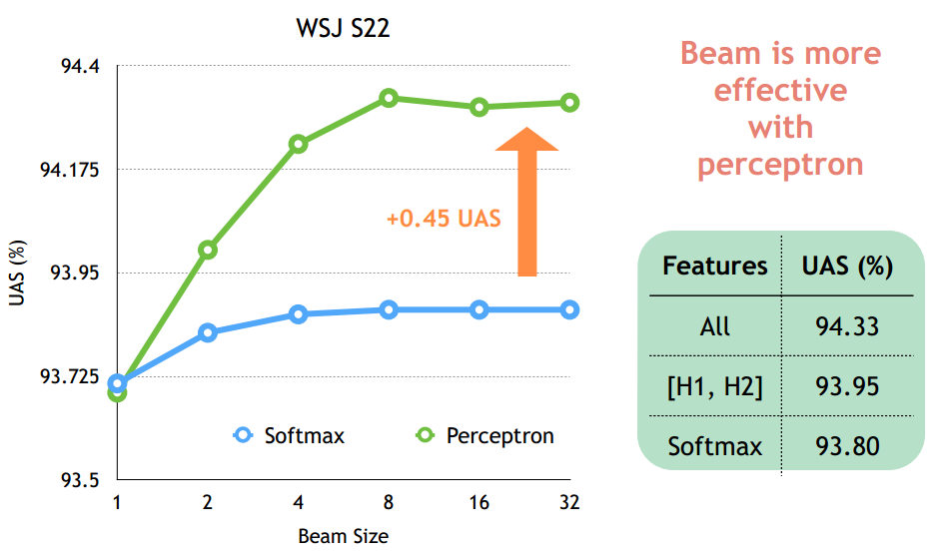
Structured vs. non-structured training:
WSJ S22
94.4
94.175
93.95
UAS
93.725
Softmax
Perceptron
93.5
1
2
4
8
16
32
Beam Size

Slide 37

Outline
WSJ §23
Method
UAS LAS Beam
Baseline (Chen & Manning, 2014)
91.80 89.60
1
3rd-order Graph-based (ZM2014)
93.22 91.02
-
Transition-based Linear (ZN2011)
93.00 90.95
32
Ours (Better SGD)
92.58 90.54
1
1
Ours (Deeper network)
93.19 91.18
1
2
Ours (Perceptron)
93.99 92.05
8
3
Ours (+Semi-supervised)
94.26 92.41
8
S-LSTM (Dyer et al.,2015)
93.20 90.90
1
Contrastive NN (Zhou et al., 2015)
92.83
—
100

Slide 38
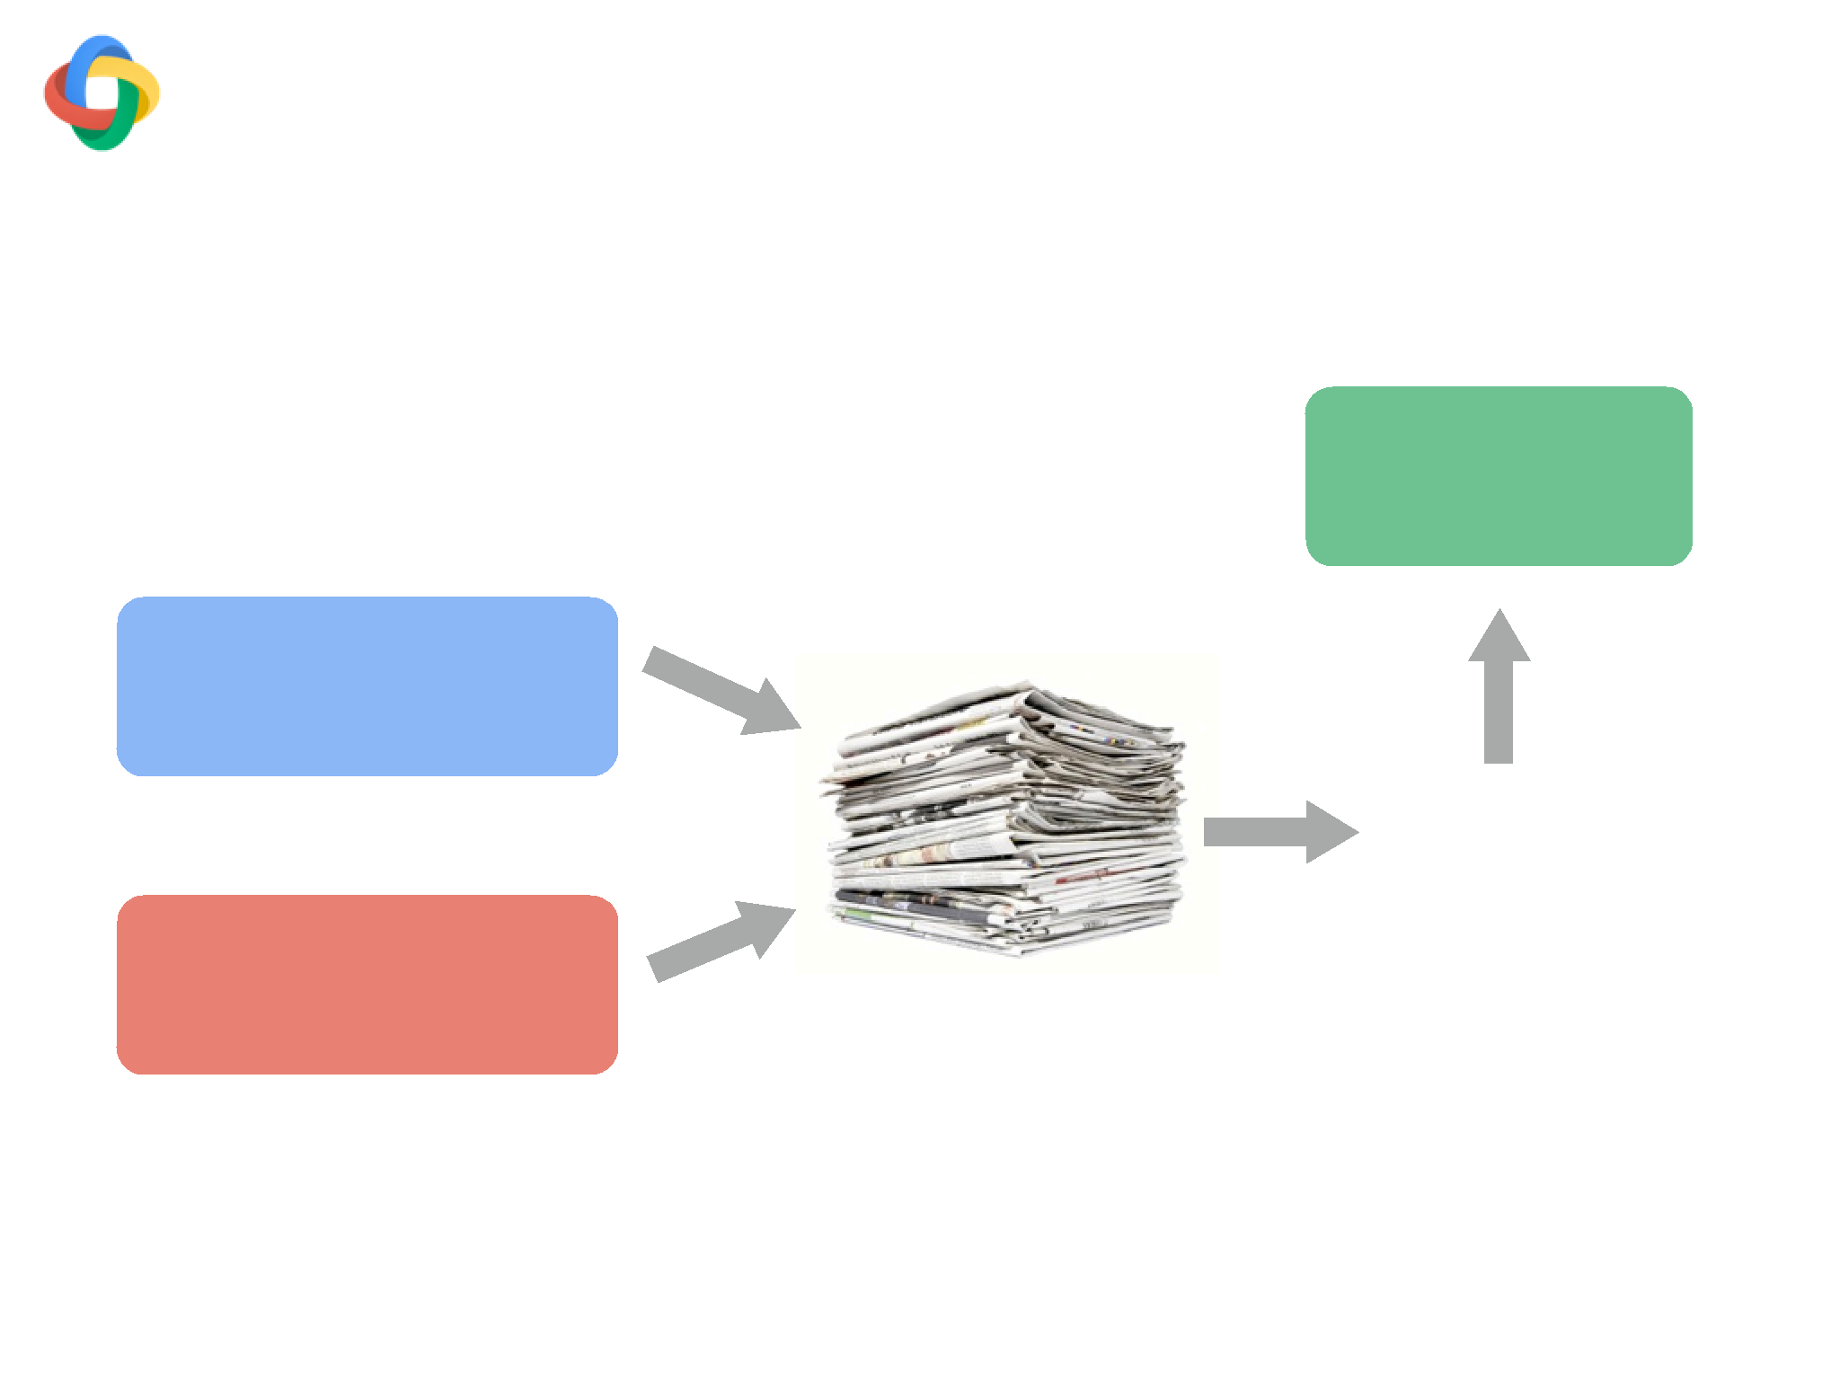
[Zhou et al 2005, Li et al, 2014]
Semi-supervised learning:
“Tri-training”
• Run 2 baseline parsers on unlabeled news
• Select sentences where parsers agree
• Add to training set
Neural Net
Linear
93.00% UAS
36% agree
Berkeley
10M tokens
93.61% UAS
97.26% UAS (WSJ S24)

Slide 39
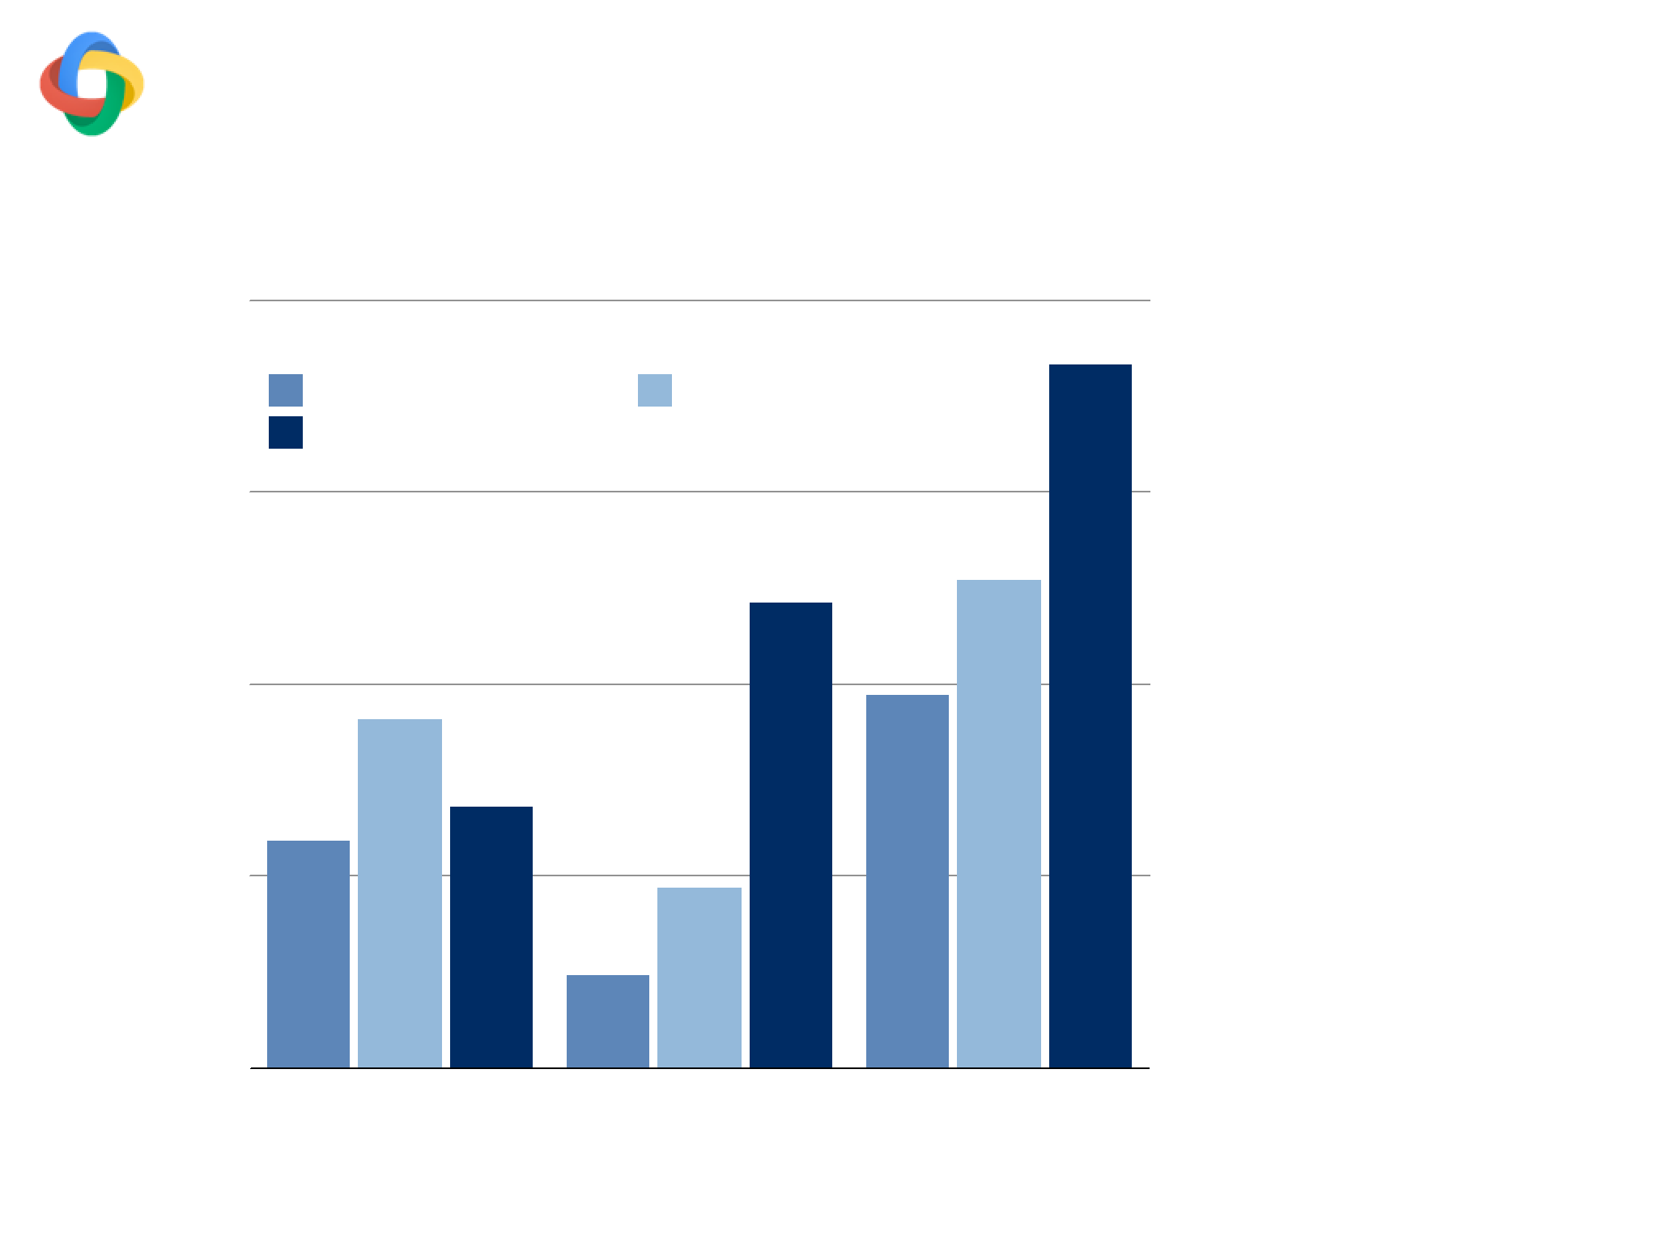
Impact of tri-training
WSJ §22 (Dev)
94.5
WSJ
WSJ+Up-training
WSJ+Tri-training
NN model
94
benefits more
from additional
data
93.5
UAS
(Linear a wash
even with other
93
baselines)
92.5
Linear (ZN2011)
NN (B=1)
NN (B=8)
Model

Slide 40

Outline
WSJ §23
Method
UAS LAS Beam
Baseline (Chen & Manning, 2014)
91.80 89.60
1
3rd-order Graph-based (ZM2014)
93.22 91.02
-
Transition-based Linear (ZN2011)
93.00 90.95
32
Ours (Better SGD)
92.58 90.54
1
1
Ours (Deeper network)
93.19 91.18
1
2
Ours (Perceptron)
93.99 92.05
8
3
Ours (+Semi-supervised)
94.26 92.41
8
S-LSTM (Dyer et al.,2015)
93.20 90.90
1
Contrastive NN (Zhou et al., 2015)
92.83
—
100

Slide 41
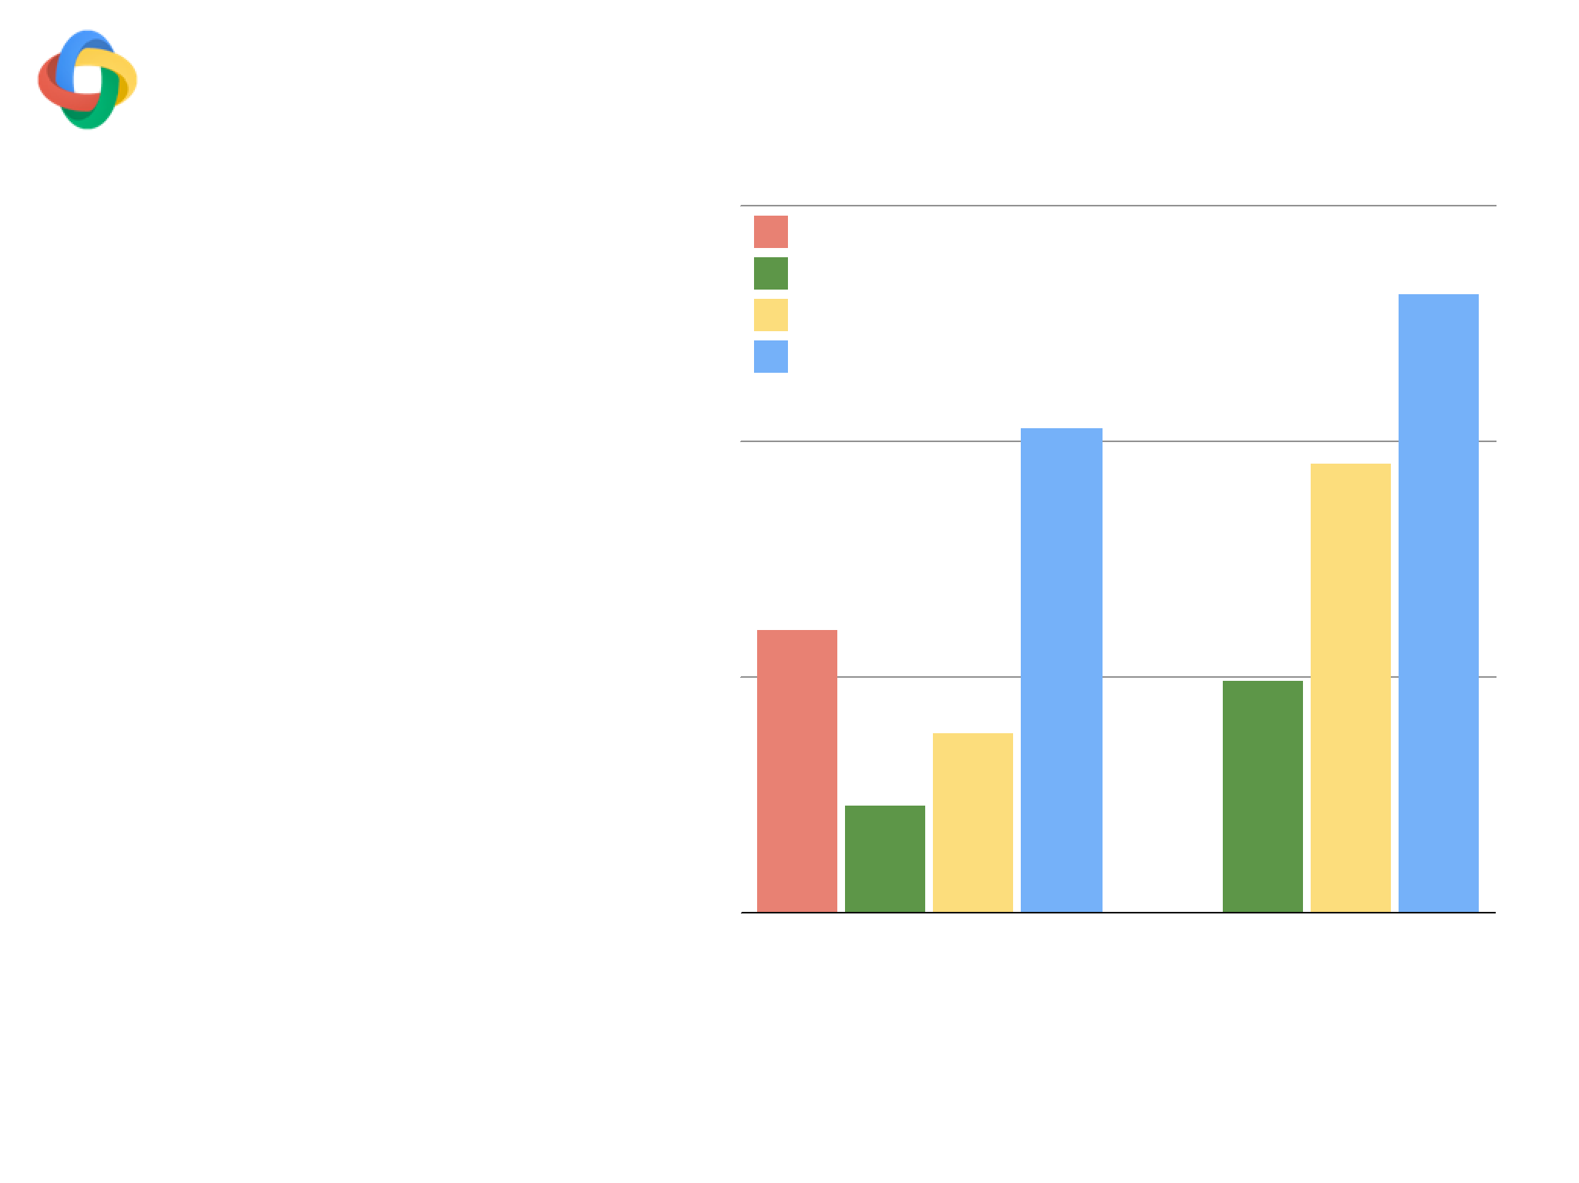
English Web Domain
90
3rd Order Graph (ZM2014)
Transition-based Linear (B=32)
-
Training set:
Transition-based NN (B=1)
Transition-based NN (B=8)
- WSJ
- OntoNotes Web
89.25
- Question Treebank
Test set:
UAS
-
- Web domain only
88.5
NN model: easy
to crank up
power
87.75
Supervised
Semi-Supervised

Slide 42
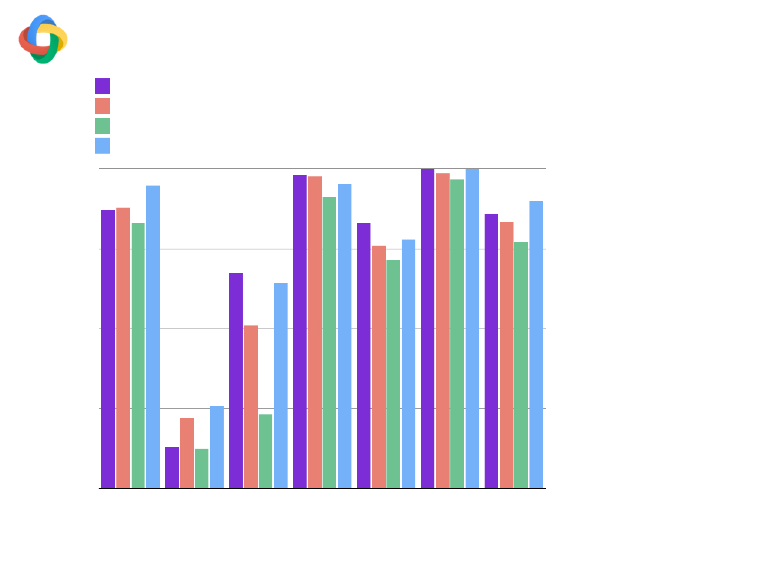
CoNLL2009 Test Set
Tensor-based Graph (Lei et al. 2014)
3rd-Order Graph (ZM2014)
Transition-based Linear (B=32)
Transition-based NN (B=32)
93
UAS: 3/7 “Wins”
LAS: 7/7 “wins”
89.75
The “recipe”
86.5
UAS
generalizes
to other
83.25
languages
80
Catalan Chinese
Czech
English German Japanese Spanish
[Alberti et al., in submission]

Slide 43
Conclusions!

Slide 44
Structured
…
…

Slide 46
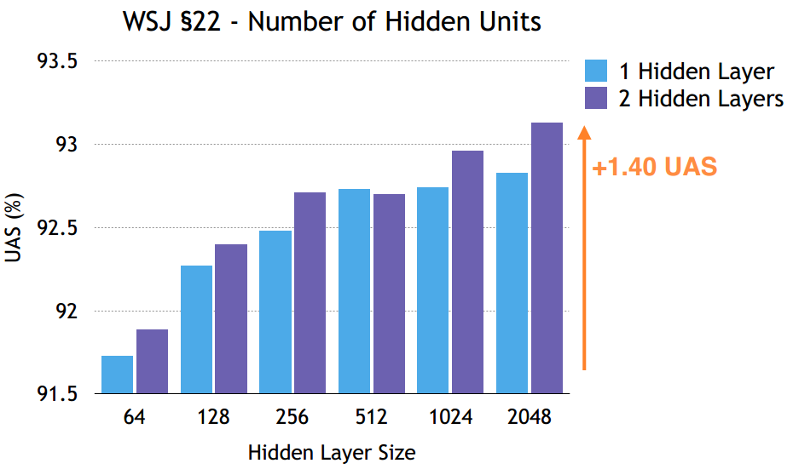

Slide 47

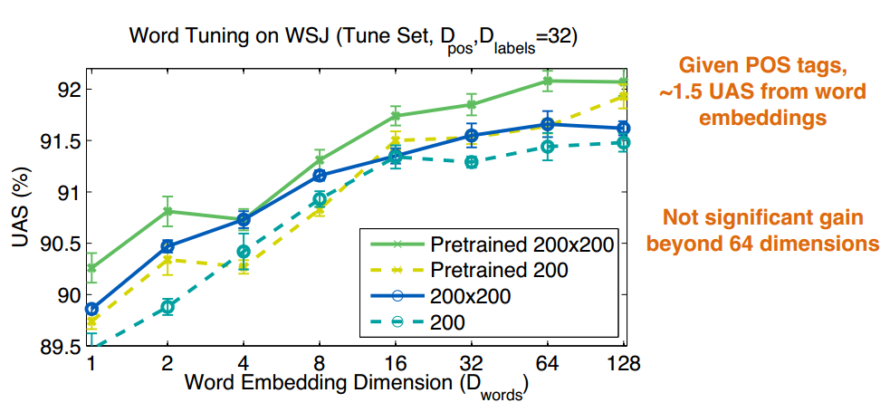
What is the impact of the embeddings?

Slide 48
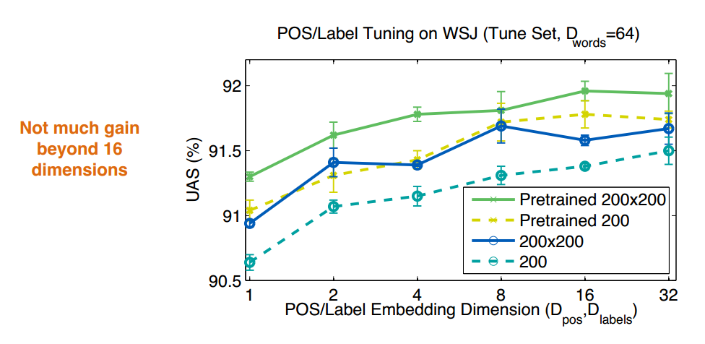
What is the impact of the embeddings?

